Slide 1
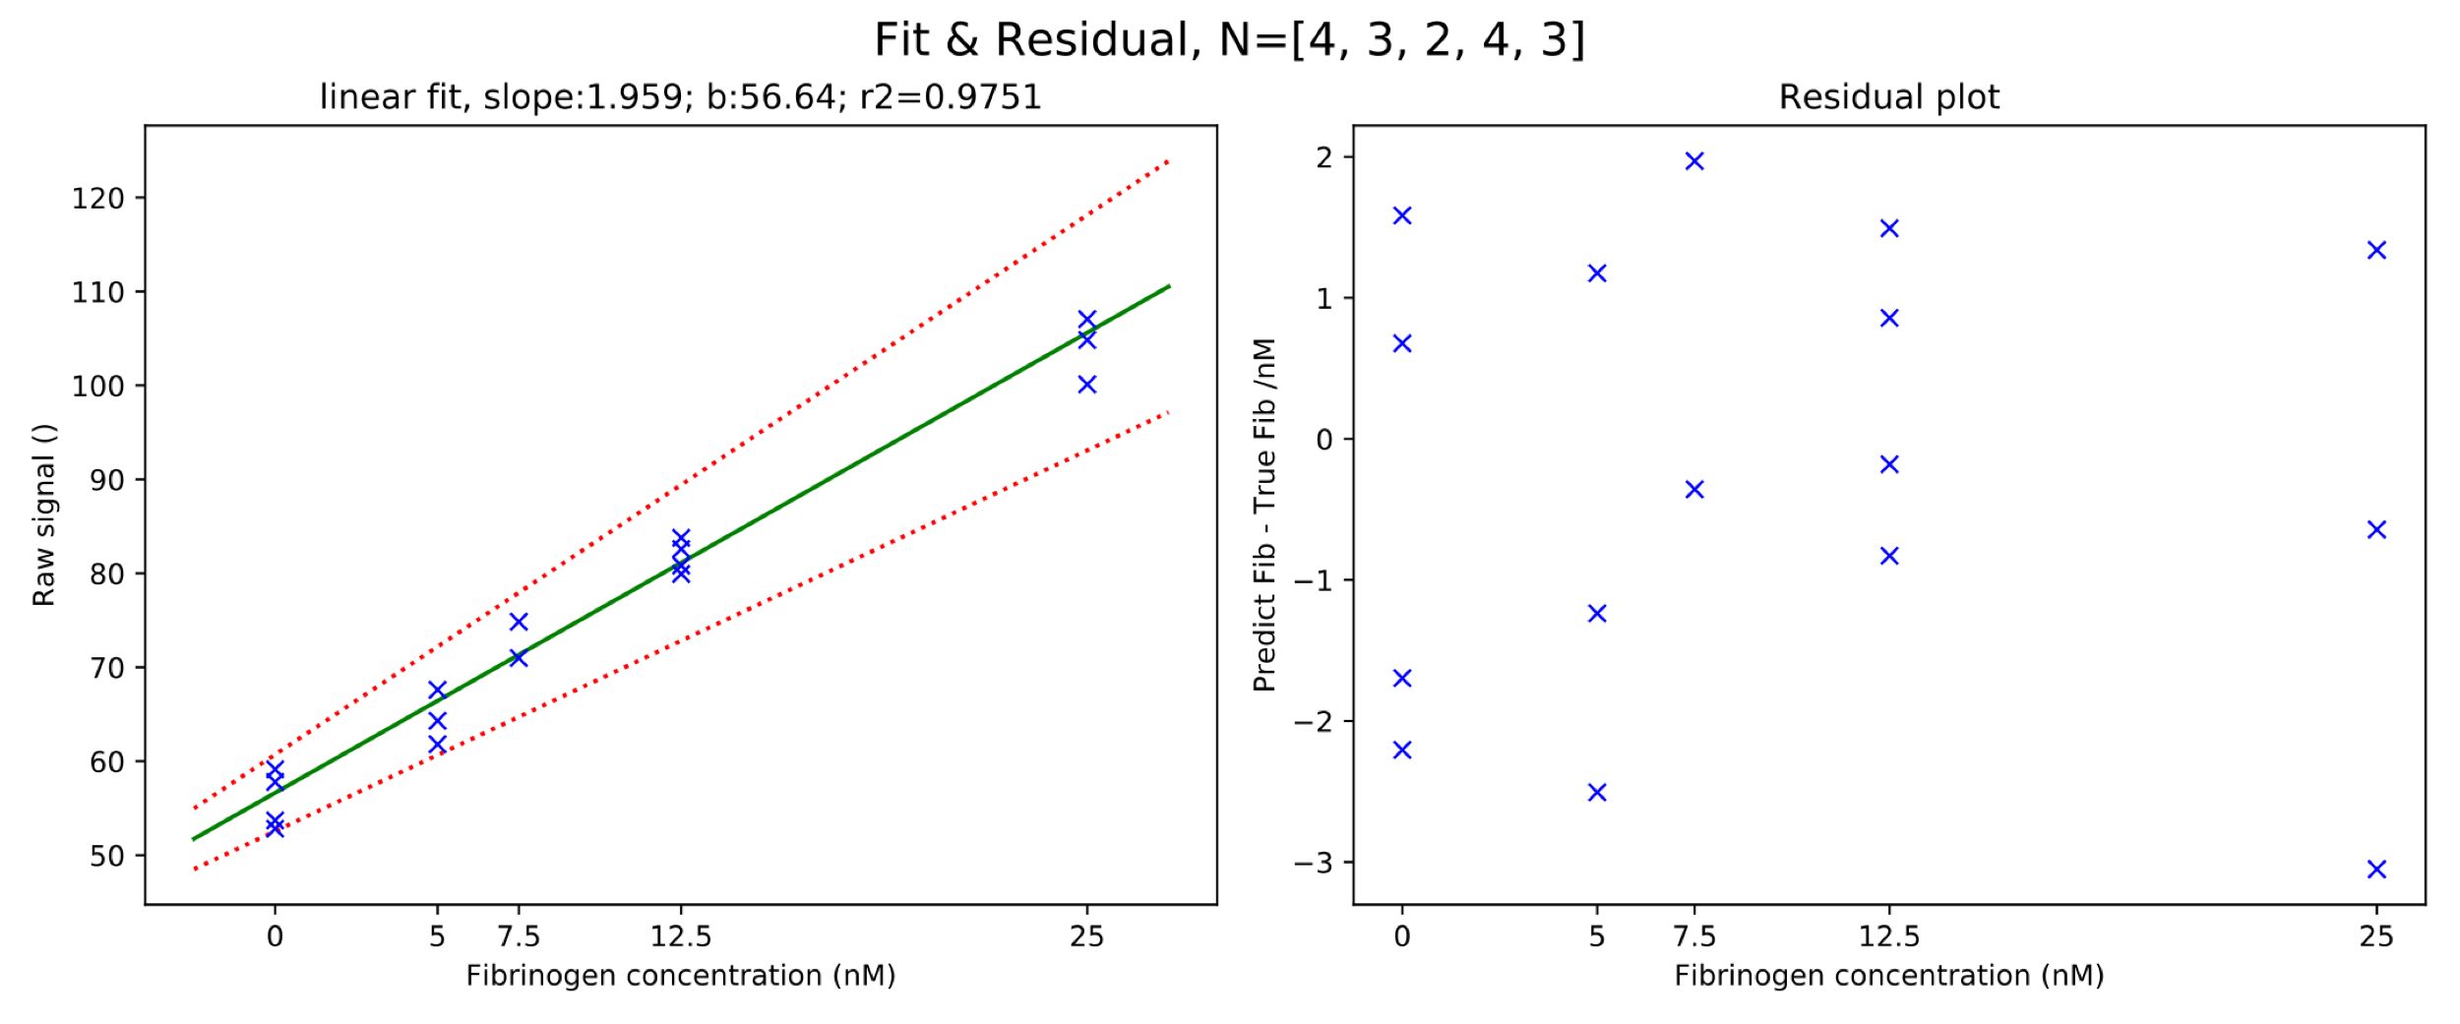
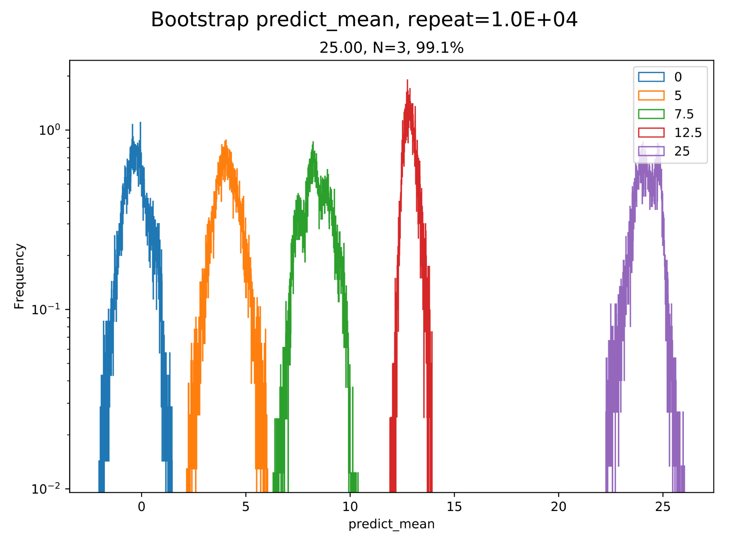
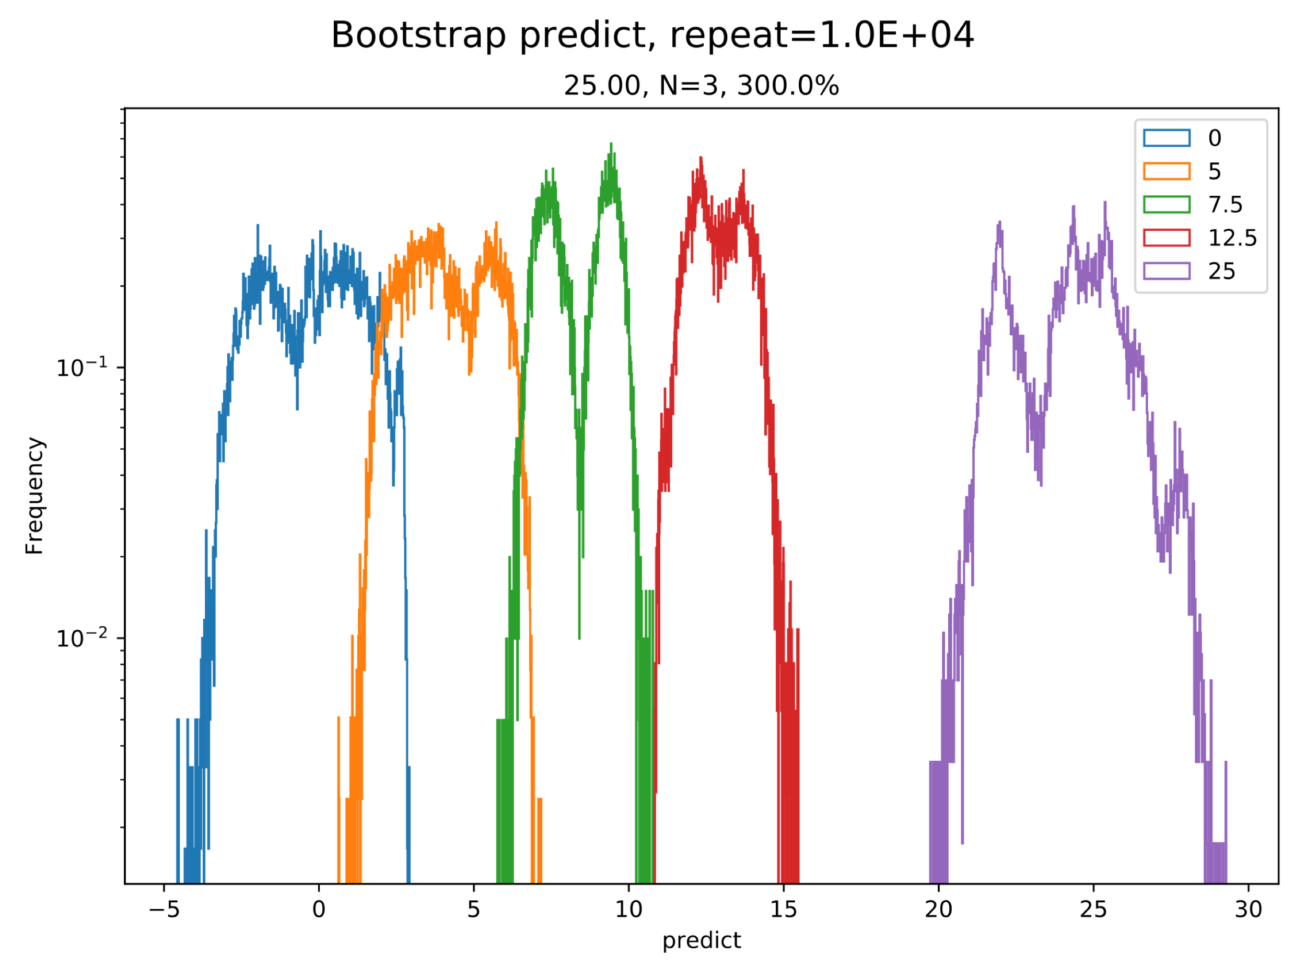
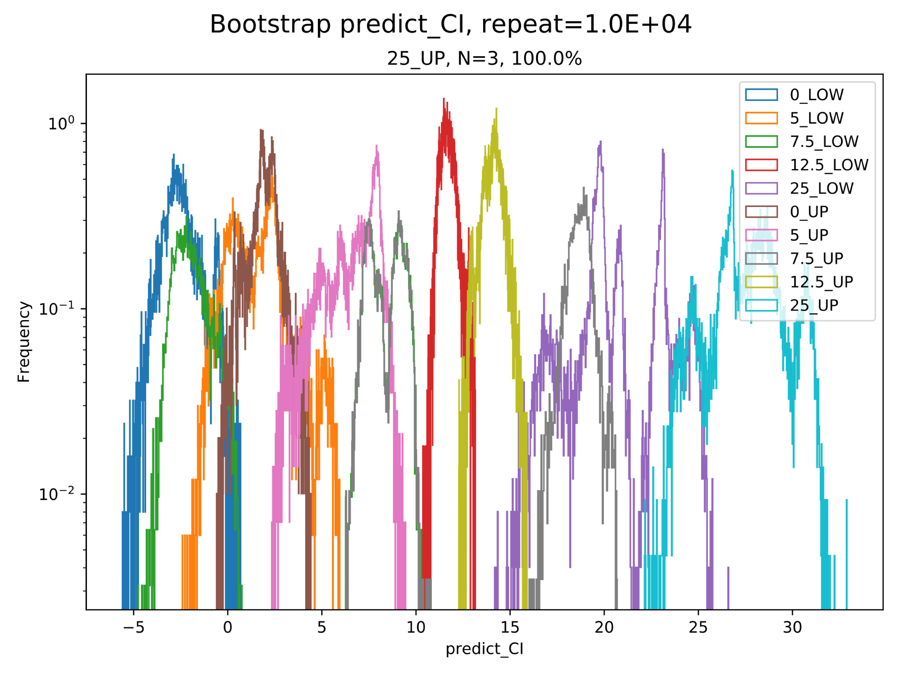
Bootstrapping from Tyler’s raw data on each chip.
TOP | Raw signal |  | Predicted Fib |  | Predicted Fib CI
Conc. | Mean | CV | Mean | CV | Lower | Upper
0 | 55.864 | 5.505 | -0.394 | 999.000 | -2.930 | 2.111
5 | 64.569 | 4.501 | 4.049 | 45.120 | 0.352 | 7.937
7.5 | 72.913 | 3.742 | 8.308 | 19.815 | -2.150 | 18.763
12.5 | 81.782 | 2.117 | 12.835 | 8.089 | 11.405 | 14.266
25 | 103.998 | 3.406 | 24.174 | 9.079 | 19.756 | 28.674
Top Electrode:

Slide 2
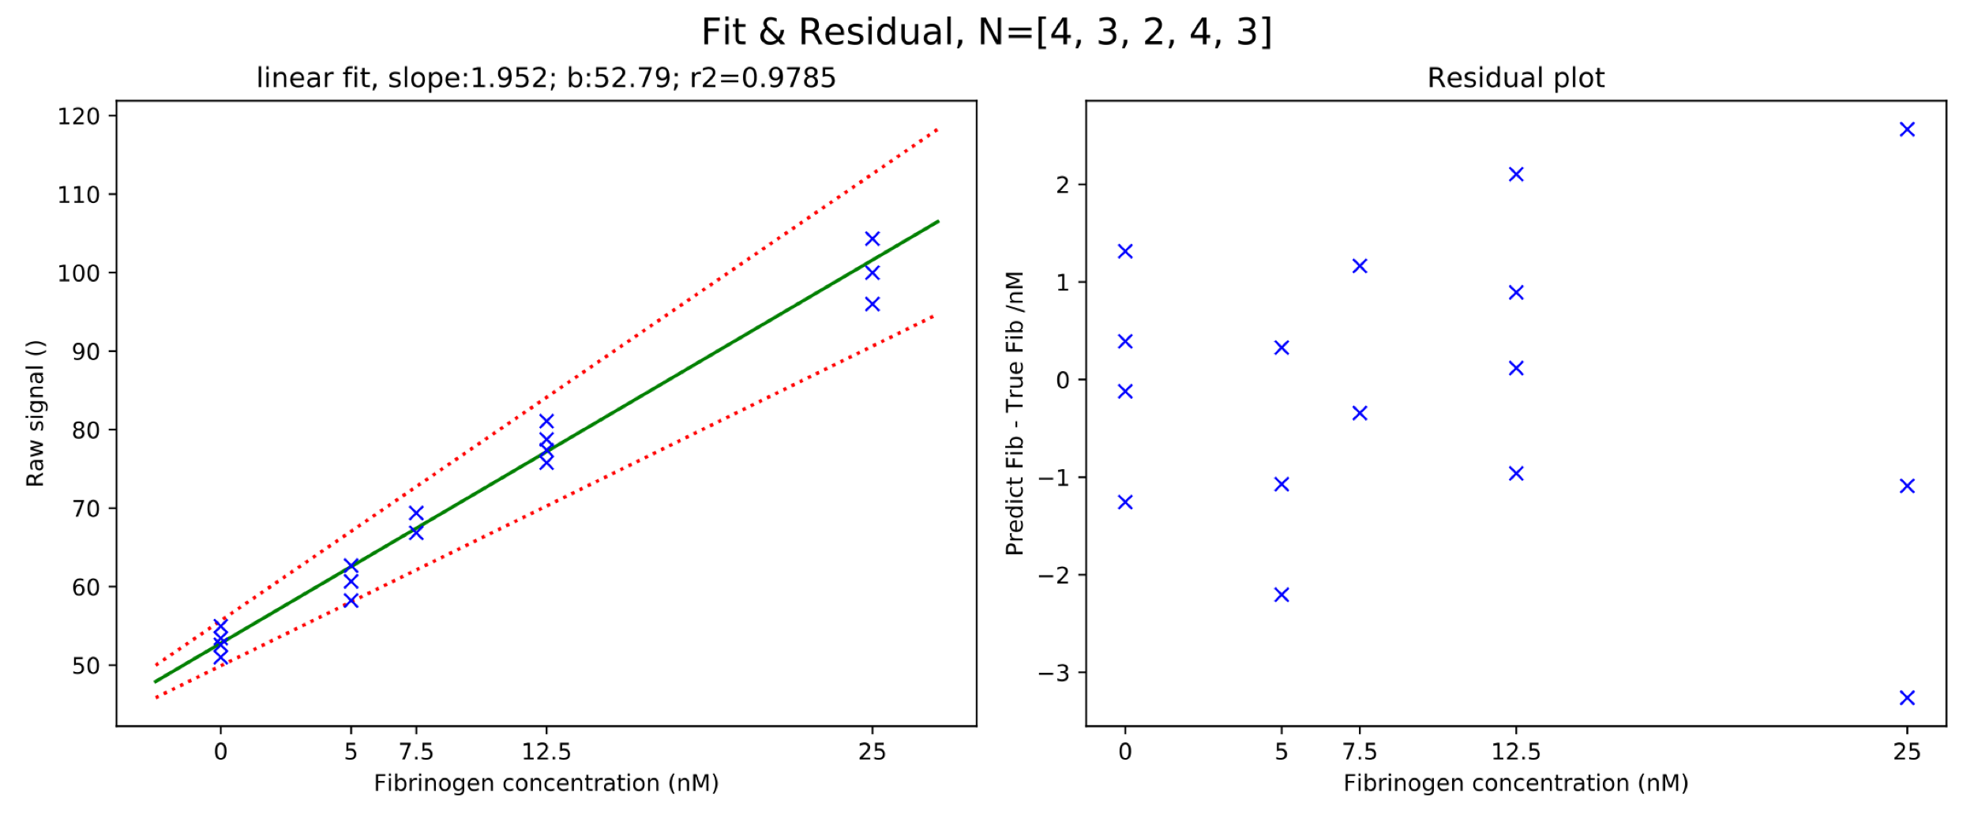
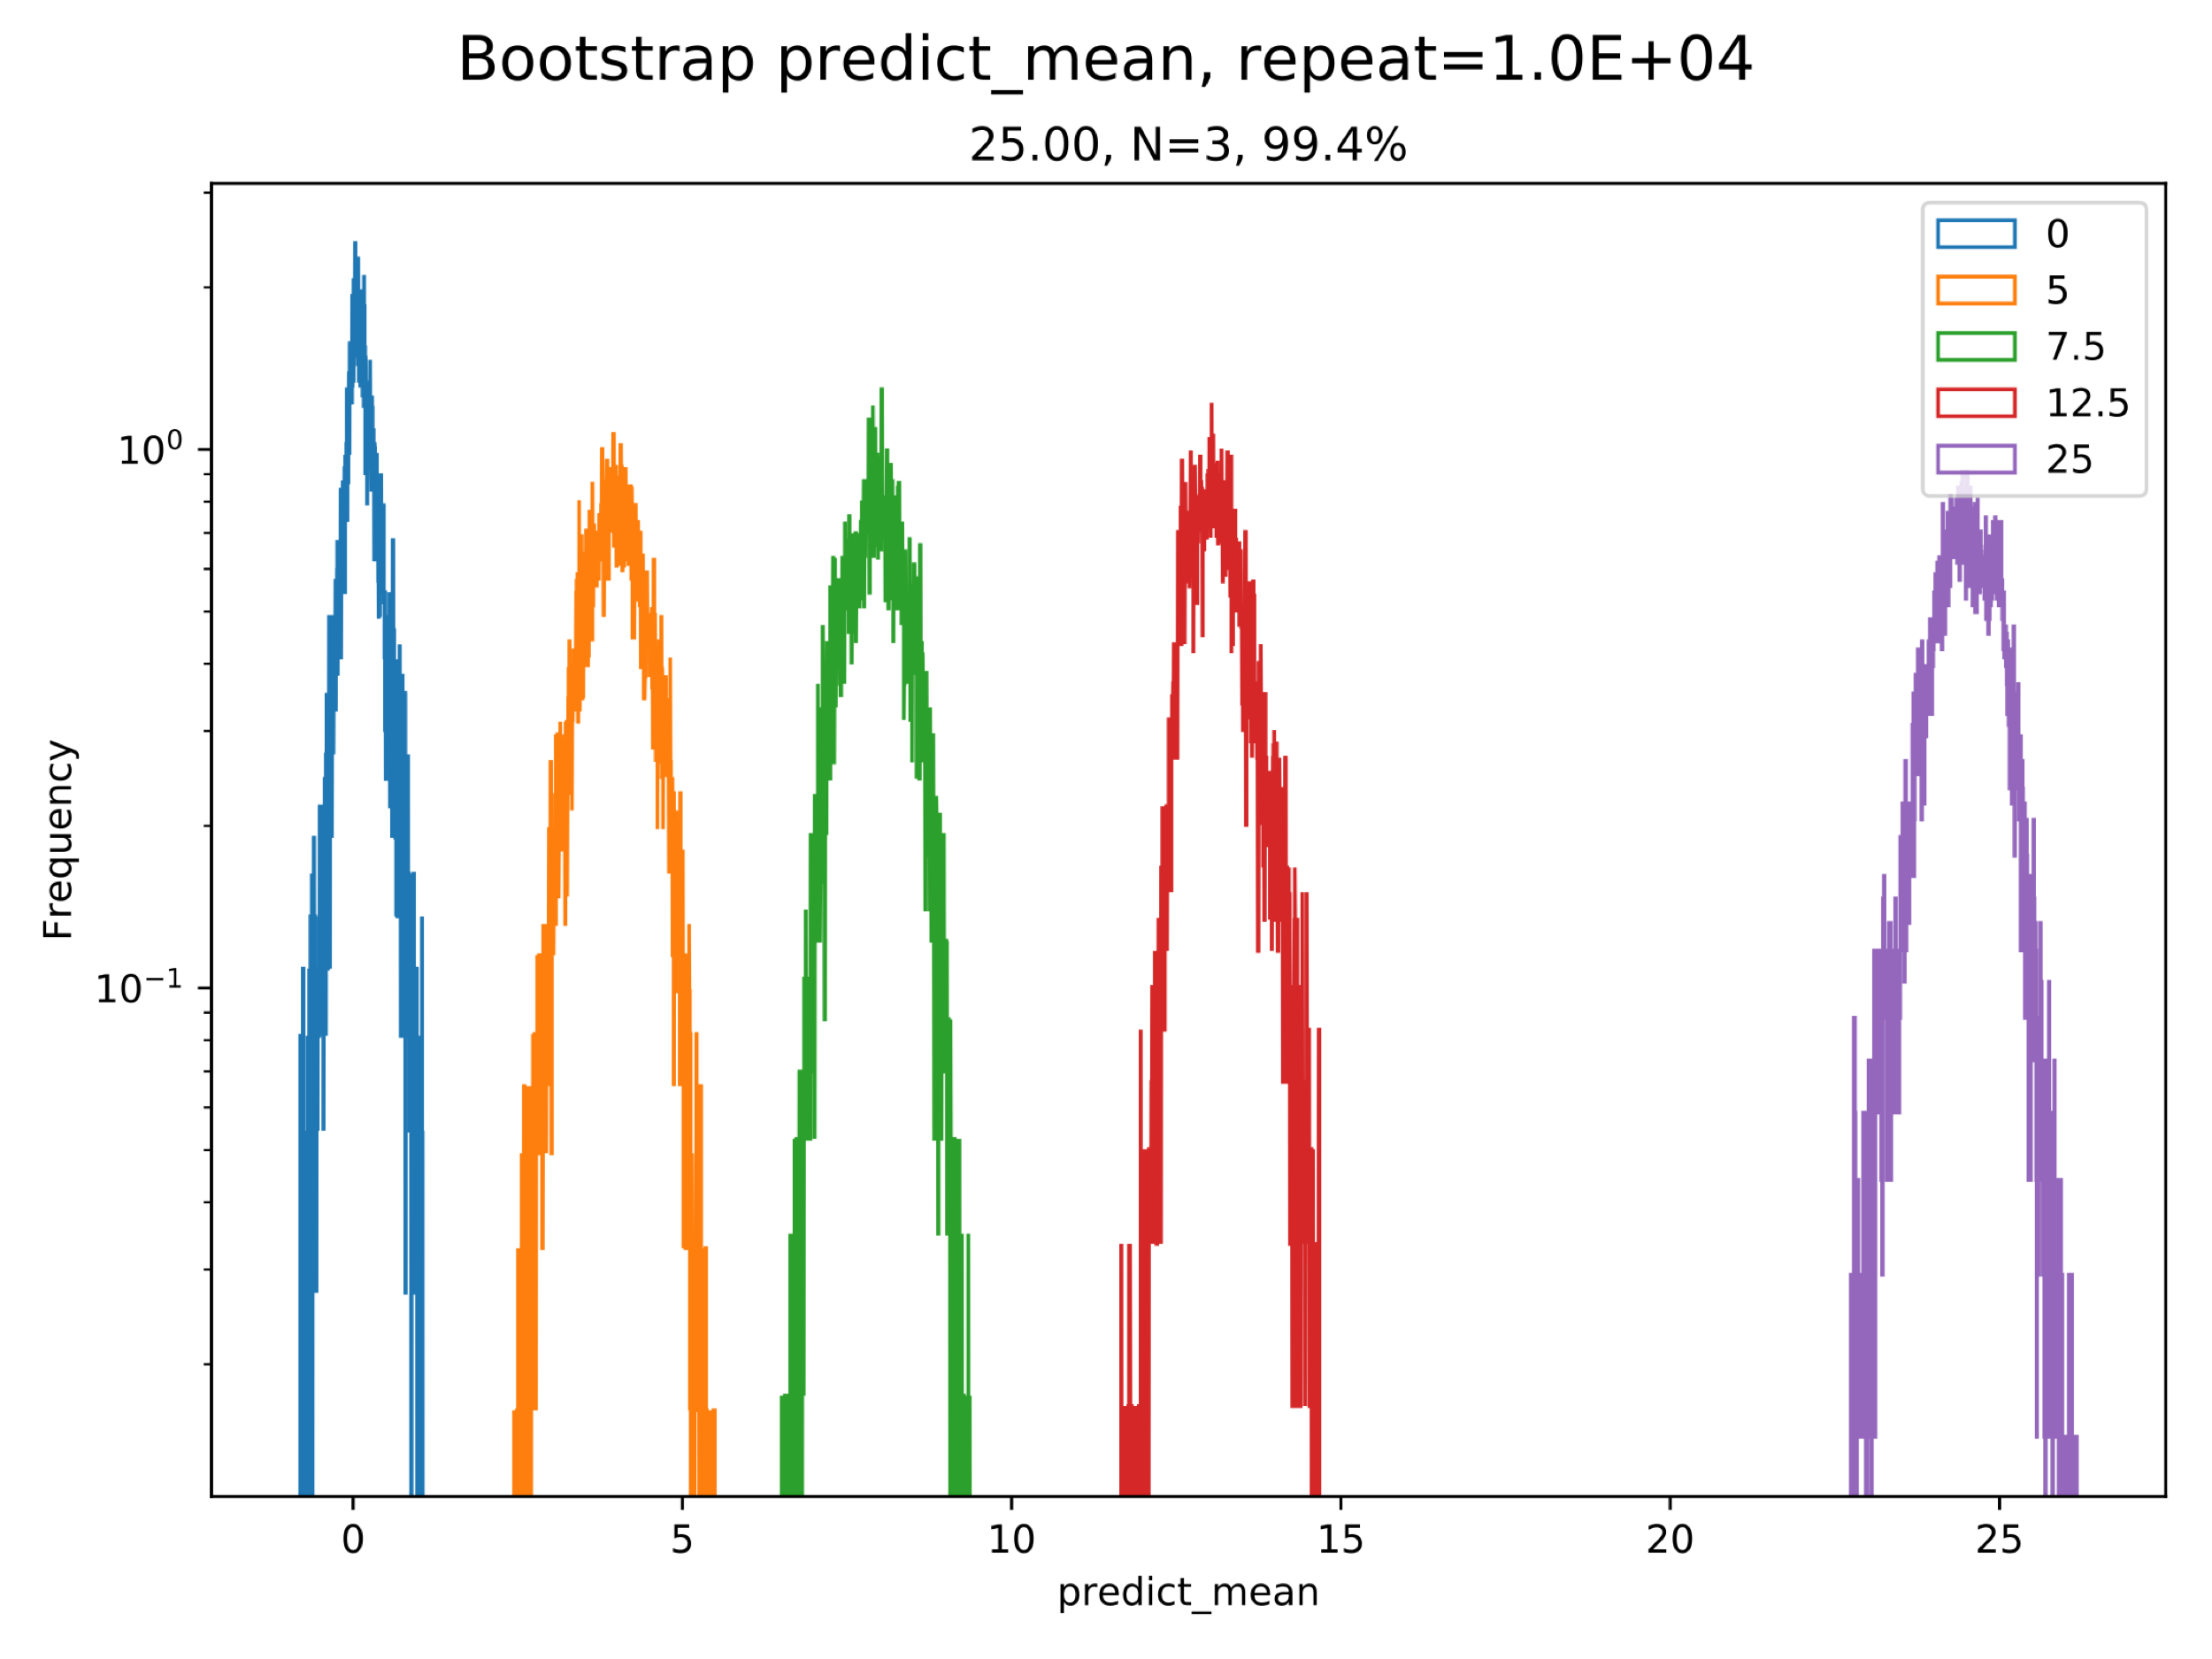
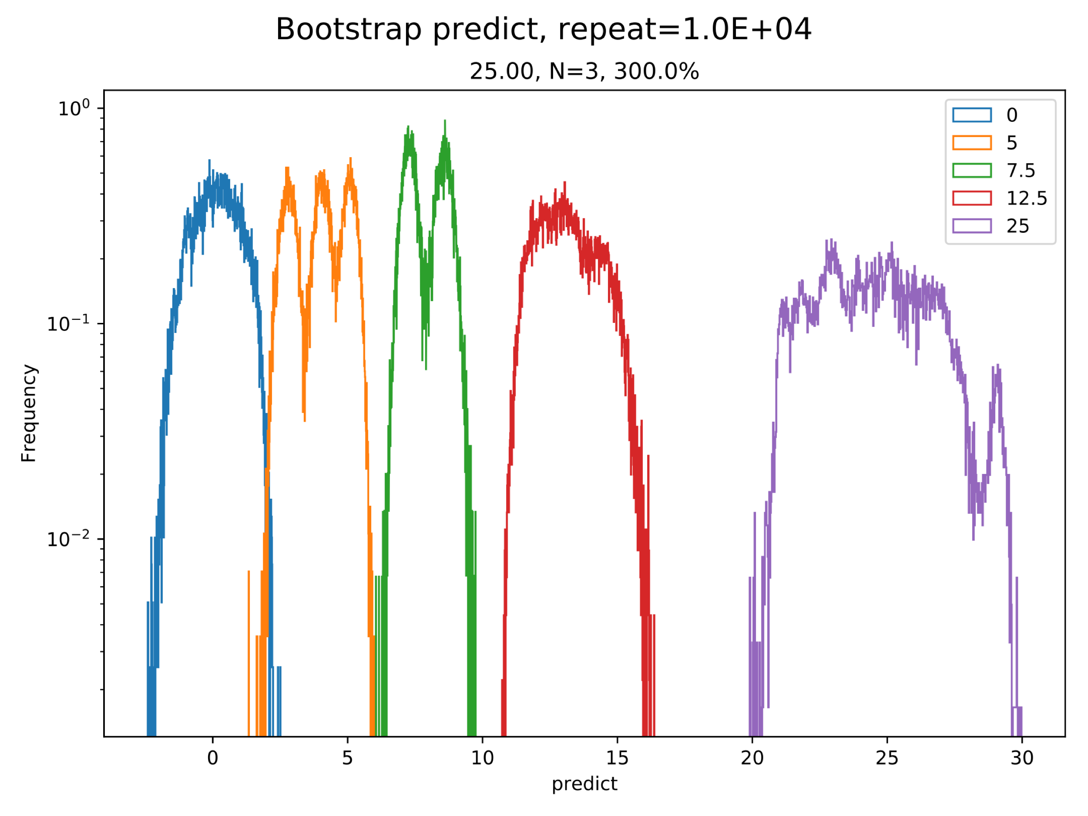
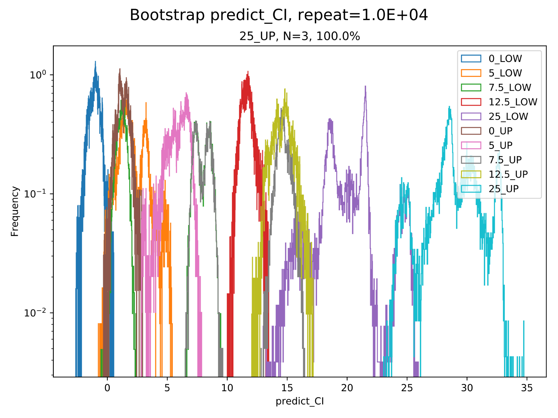
Bootstrapping from Tyler’s raw data on each chip.
Middle | Raw signal |  | Predicted Fib |  | Predicted Fib CI
Conc. | Mean | CV | Mean | CV | Lower | Upper
0 | 52.994 | 3.118 | 0.103 | 999.000 | -1.394 | 1.559
5 | 60.527 | 3.681 | 3.961 | 31.570 | 1.445 | 6.590
7.5 | 68.116 | 2.623 | 7.848 | 13.474 | 1.139 | 14.682
12.5 | 78.252 | 2.867 | 13.039 | 9.904 | 11.259 | 14.818
25 | 100.102 | 4.159 | 24.231 | 12.061 | 18.435 | 30.375
Middle Electrode:

Slide 3
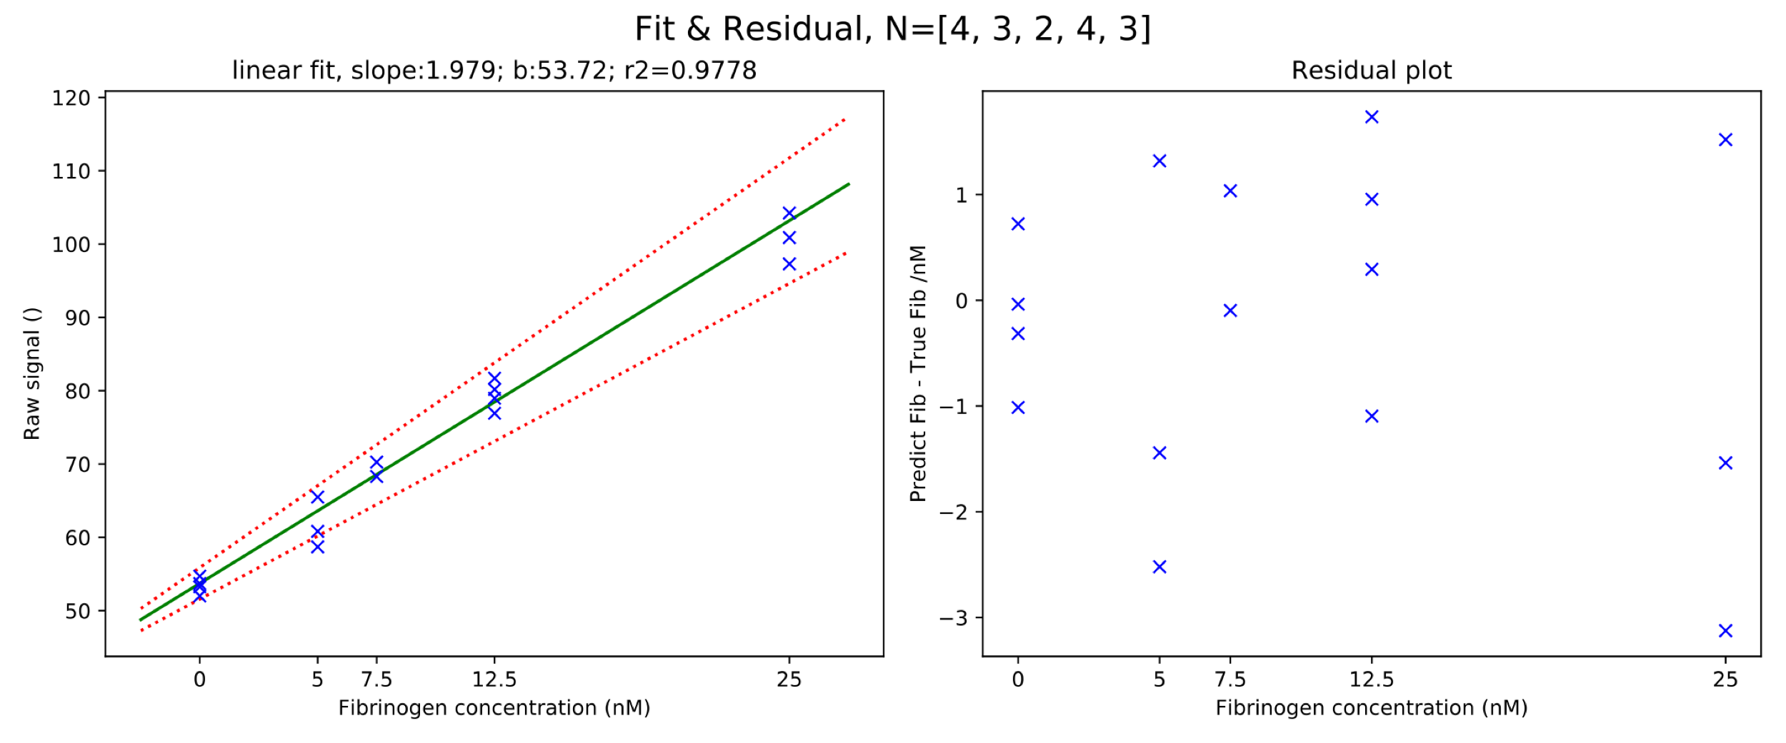
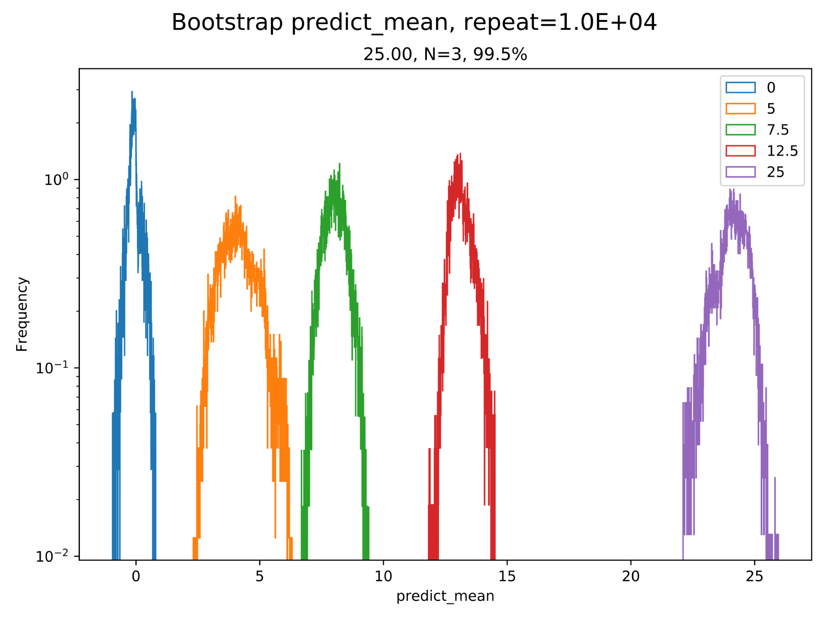
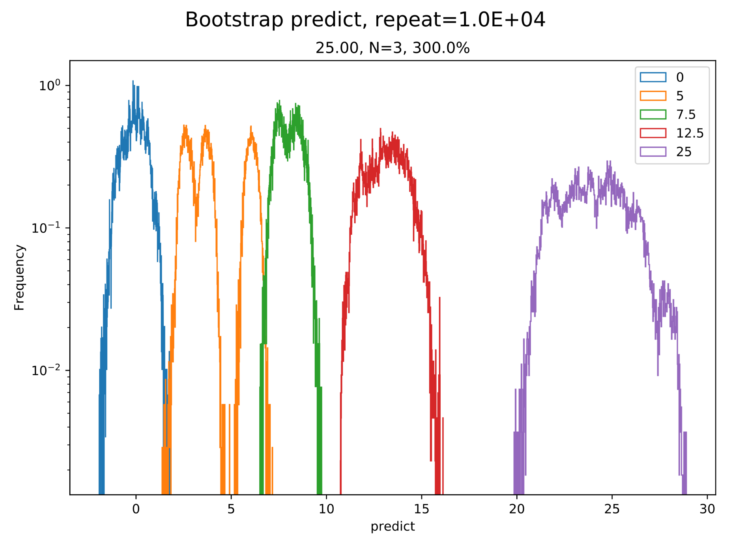
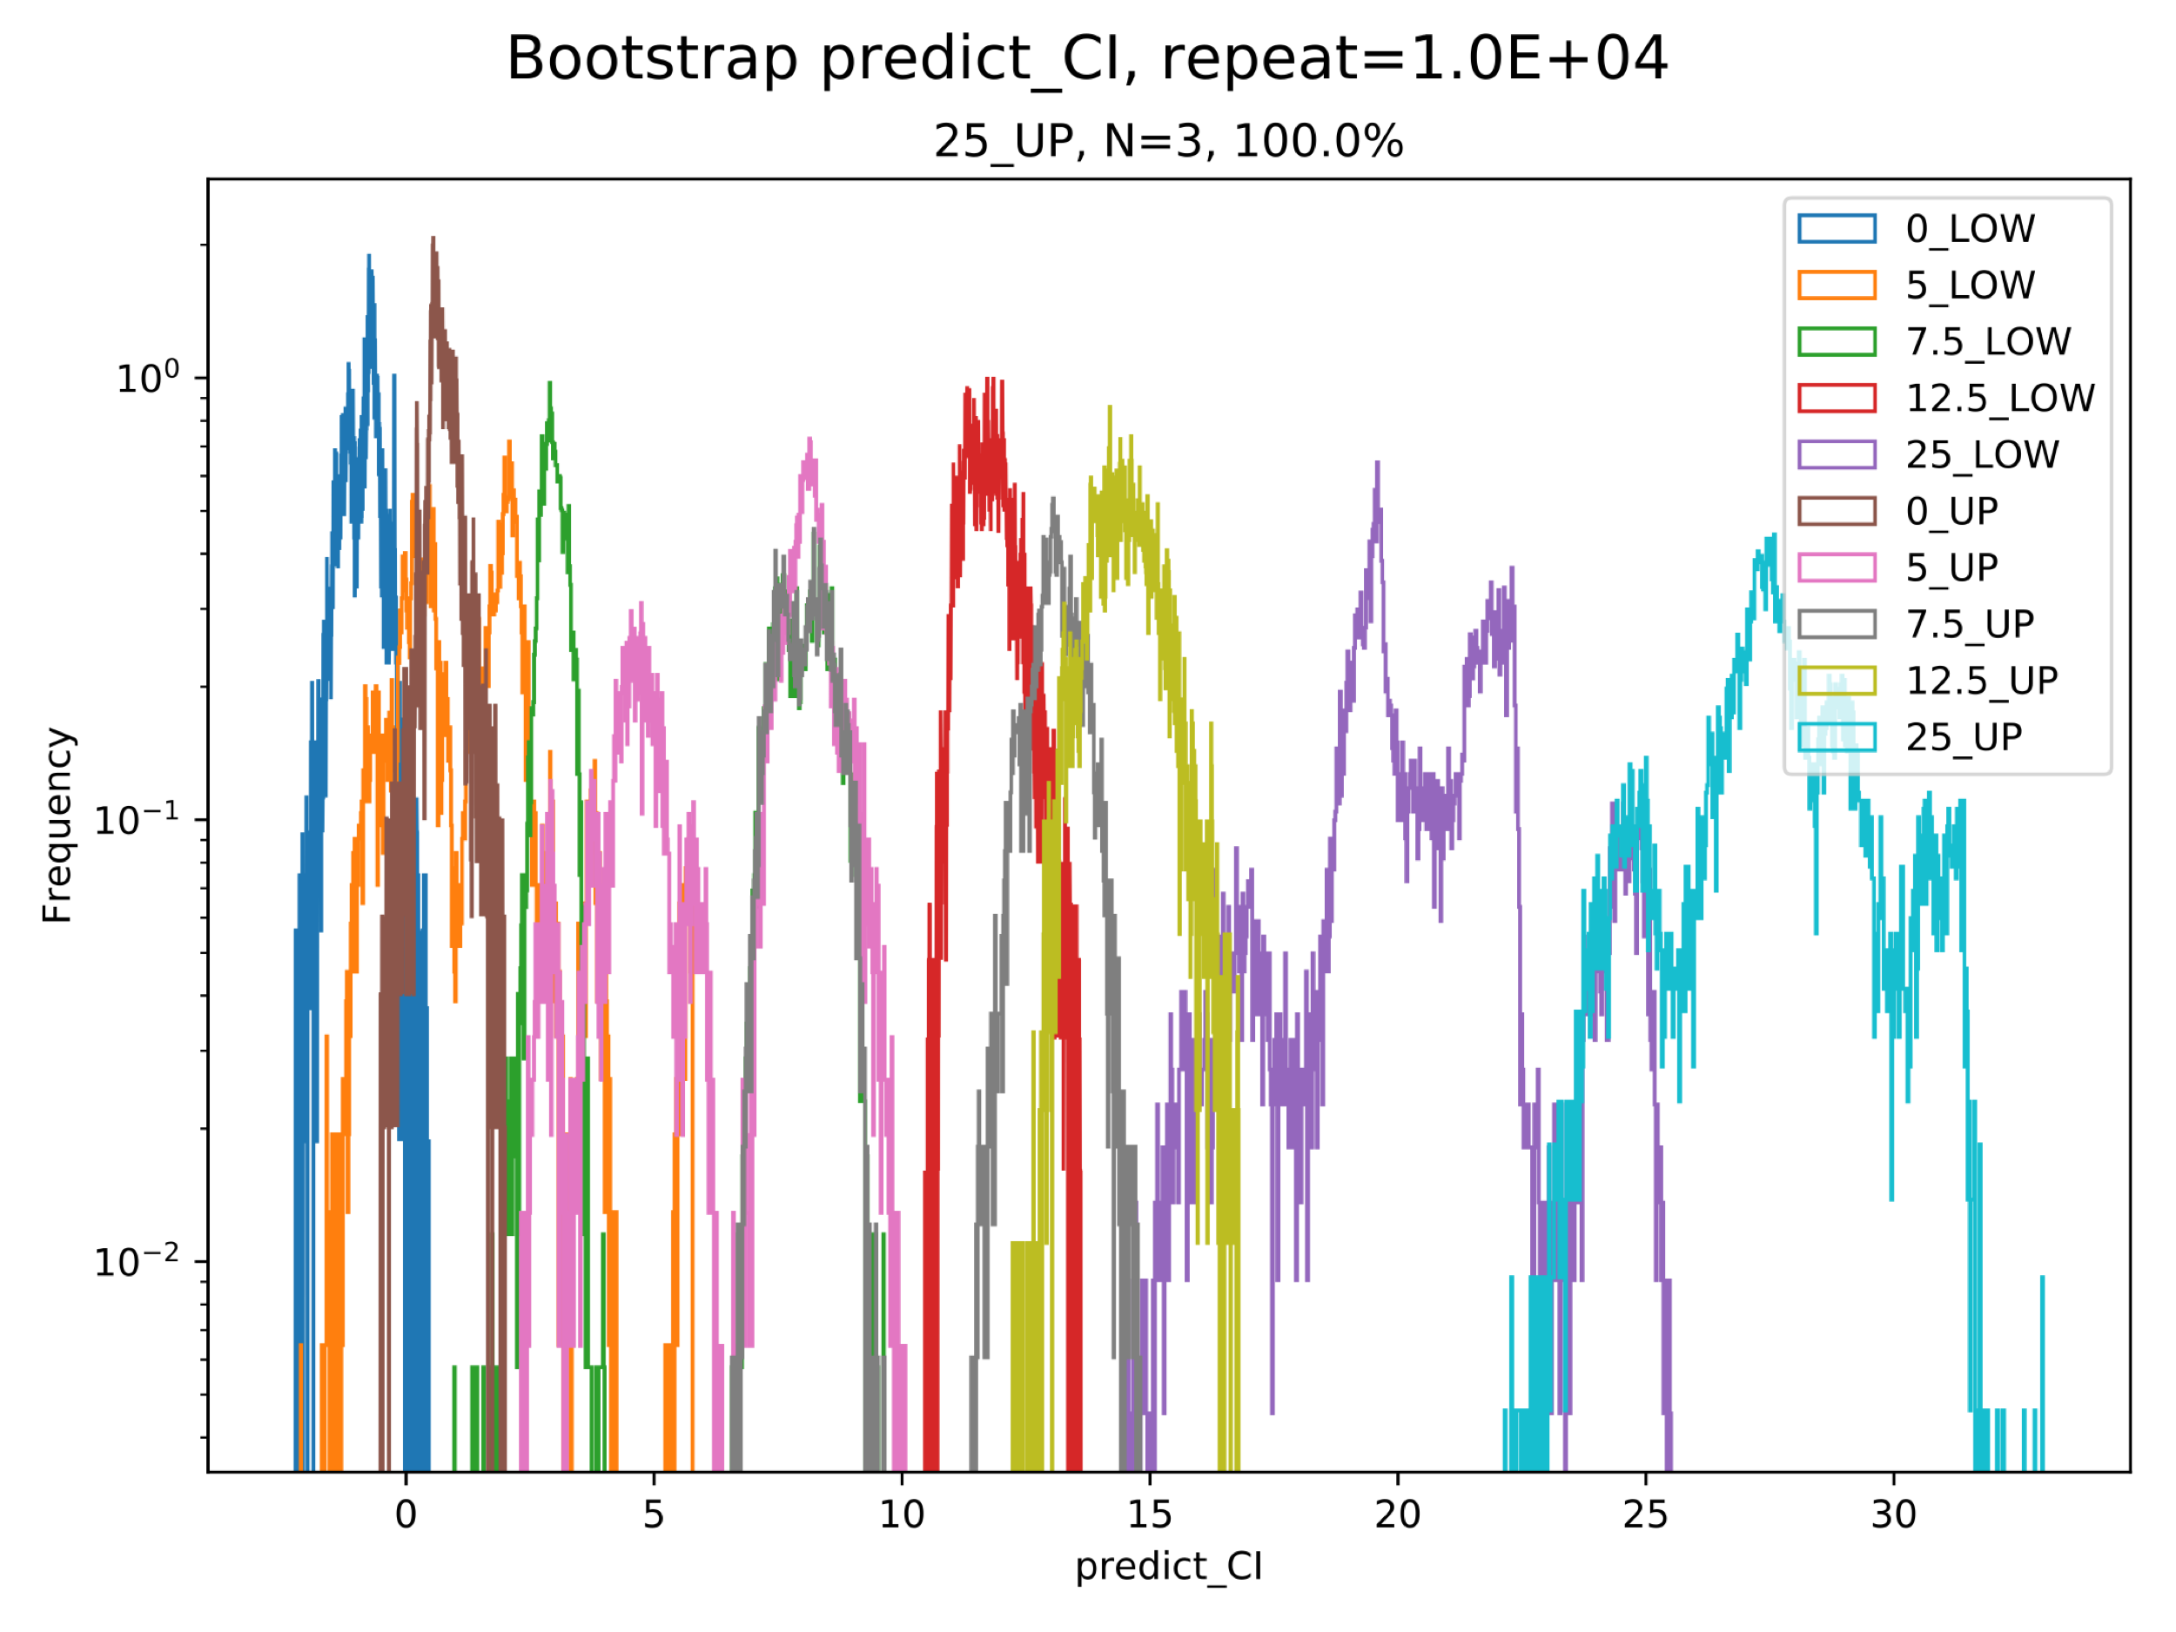
Bootstrapping from Tyler’s raw data on each chip.
Bottom | Raw signal |  | Predicted Fib |  | Predicted Fib CI
Conc. | Mean | CV | Mean | CV | Lower | Upper
0 | 53.410 | 2.091 | -0.157 | 999.000 | -1.150 | 0.829
5 | 61.669 | 5.634 | 4.017 | 48.071 | 0.103 | 8.135
7.5 | 69.274 | 2.008 | 7.859 | 10.041 | 2.886 | 13.054
12.5 | 79.440 | 2.539 | 12.996 | 9.248 | 11.319 | 14.625
25 | 100.803 | 3.444 | 23.790 | 9.856 | 19.164 | 28.741
Bottom Electrode:

Slide 4
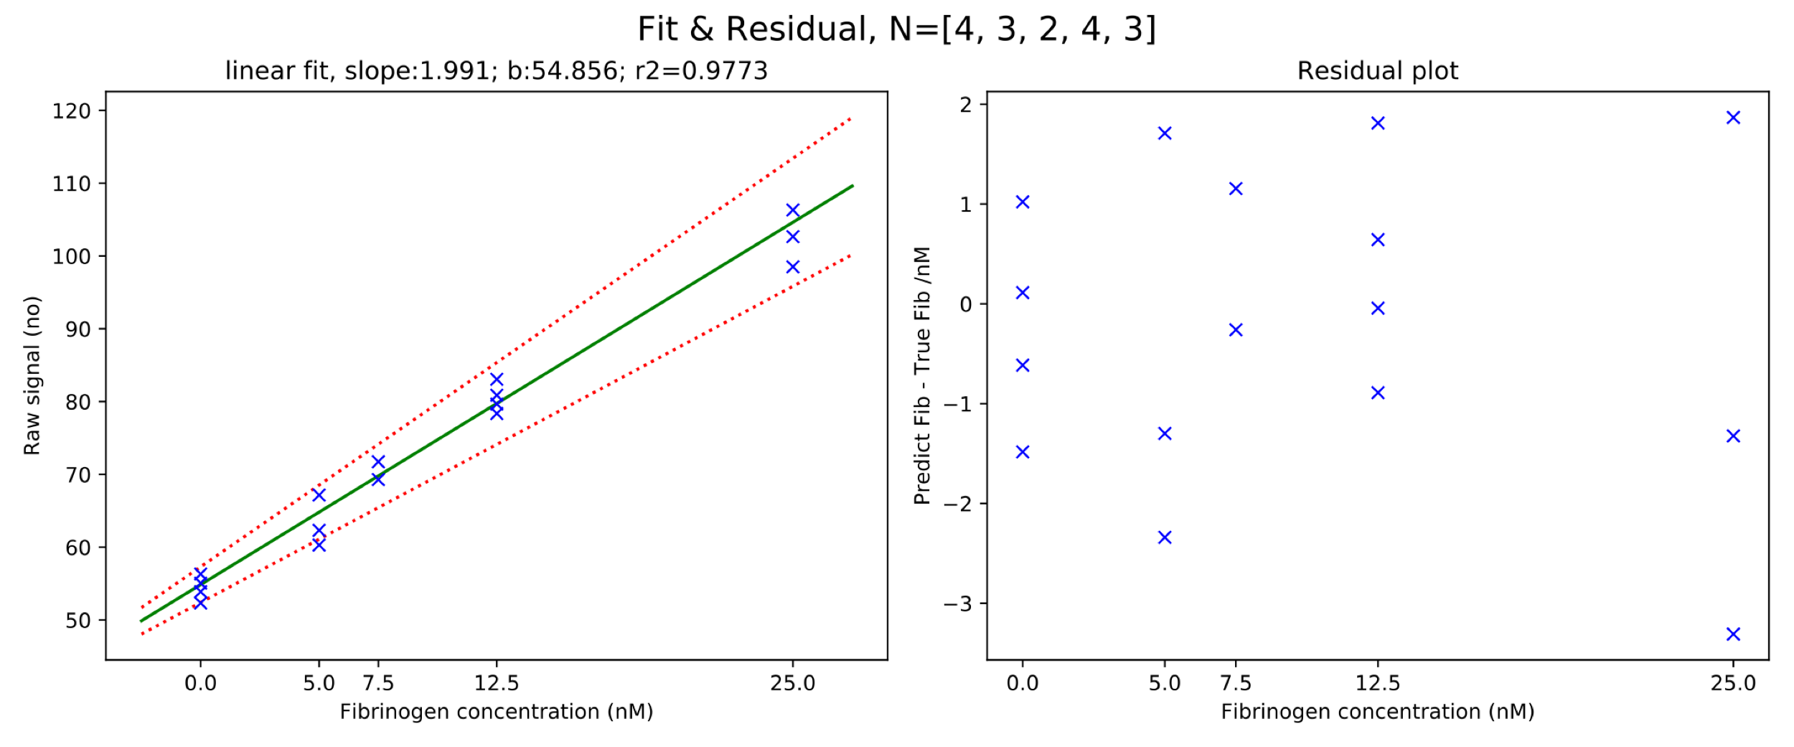
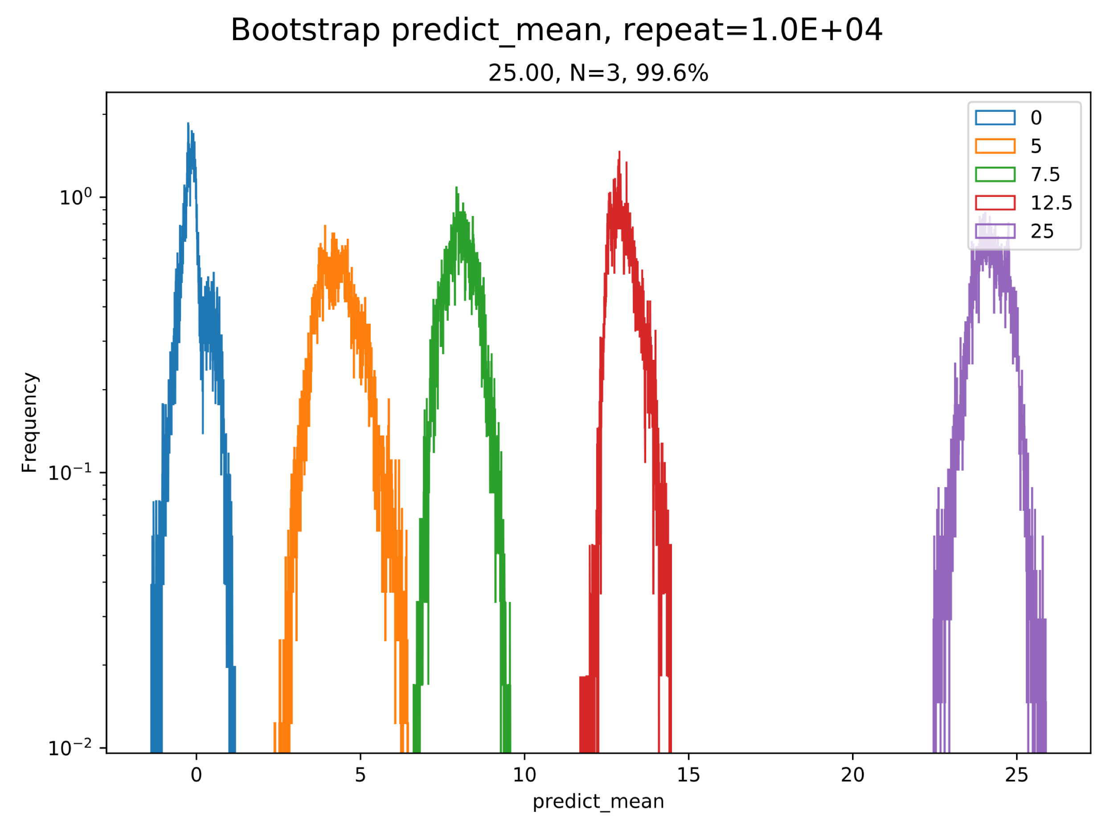
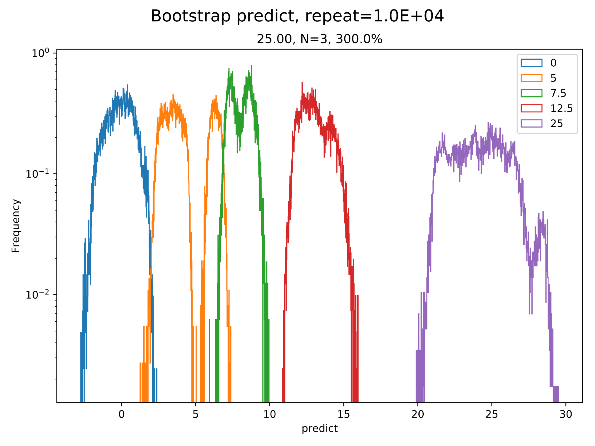
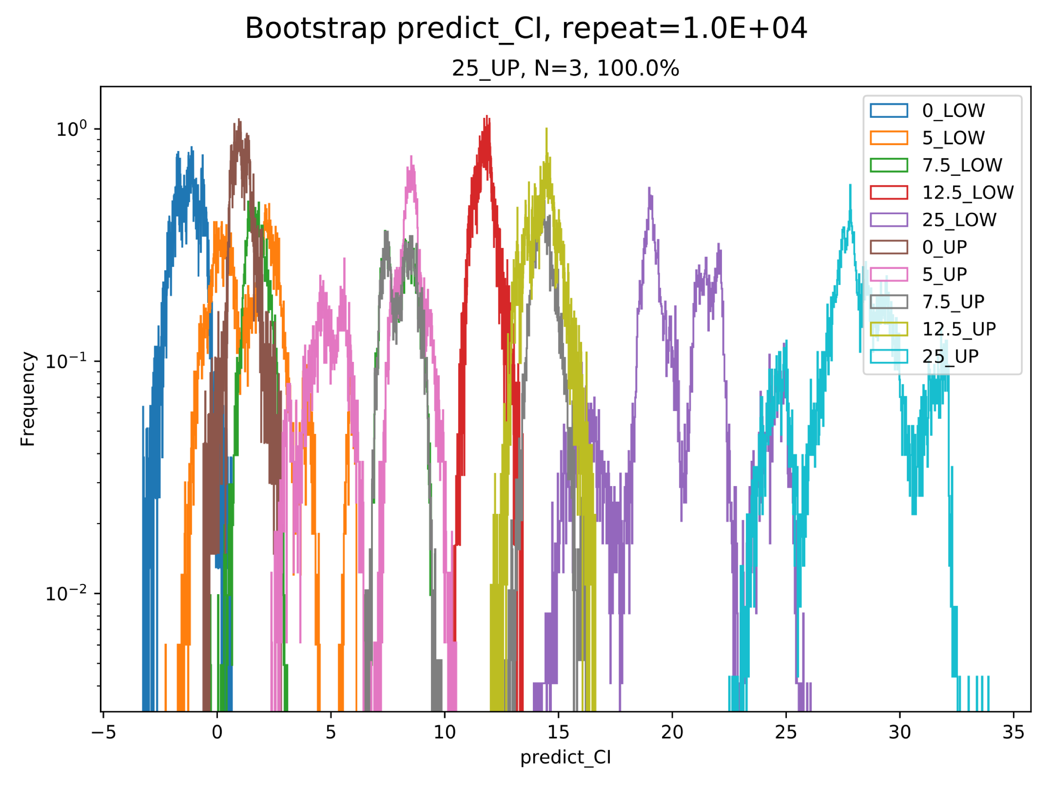
Bootstrapping from Tyler’s raw data on each chip.
AVERAGE | Raw signal |  | Predicted Fib |  | Predicted Fib CI
Conc. | Mean | CV | Mean | CV | Lower | Upper
0 | 54.392 | 3.122 | -0.233 | 999.000 | -1.709 | 1.227
5 | 63.251 | 5.579 | 4.217 | 48.265 | 0.092 | 8.623
7.5 | 70.506 | 2.457 | 7.862 | 12.591 | 1.590 | 14.305
12.5 | 80.483 | 2.486 | 12.873 | 8.864 | 11.307 | 14.454
25 | 102.492 | 3.811 | 23.929 | 10.845 | 18.782 | 29.375
Average Electrode:

Slide 5
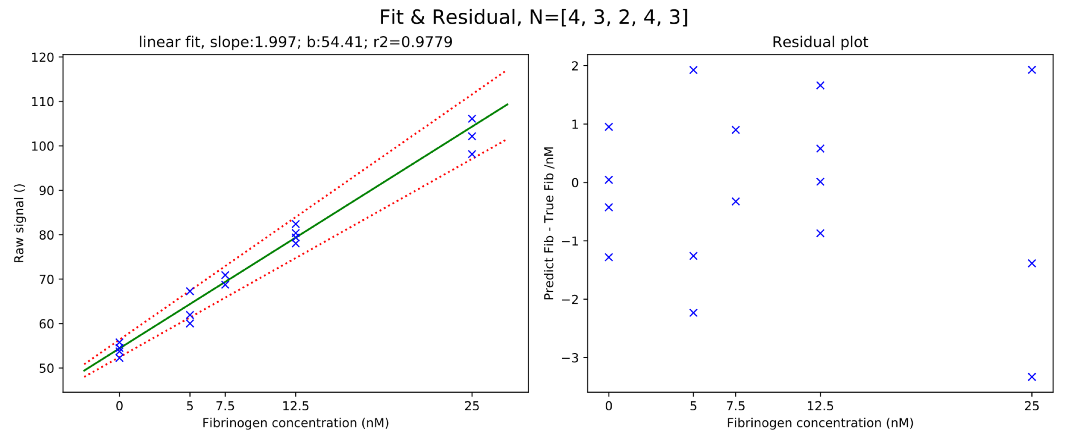
Bootstrapping from Tyler’s raw data on each chip.
MID-3 | Raw signal |  | Predicted Fib |  | Predicted Fib CI
Conc. | Mean | CV | Mean | CV | Lower | Upper
0 | 54.074 | 2.716 | -0.171 | 999.000 | -1.461 | 1.106
5 | 63.086 | 5.953 | 4.343 | 48.566 | 0.067 | 8.889
7.5 | 69.830 | 2.188 | 7.720 | 11.134 | 2.279 | 13.296
12.5 | 80.056 | 2.304 | 12.842 | 8.261 | 11.384 | 14.309
25 | 102.137 | 3.899 | 23.901 | 11.048 | 18.677 | 29.465
Middle 3 signal, Average all eod

Slide 6
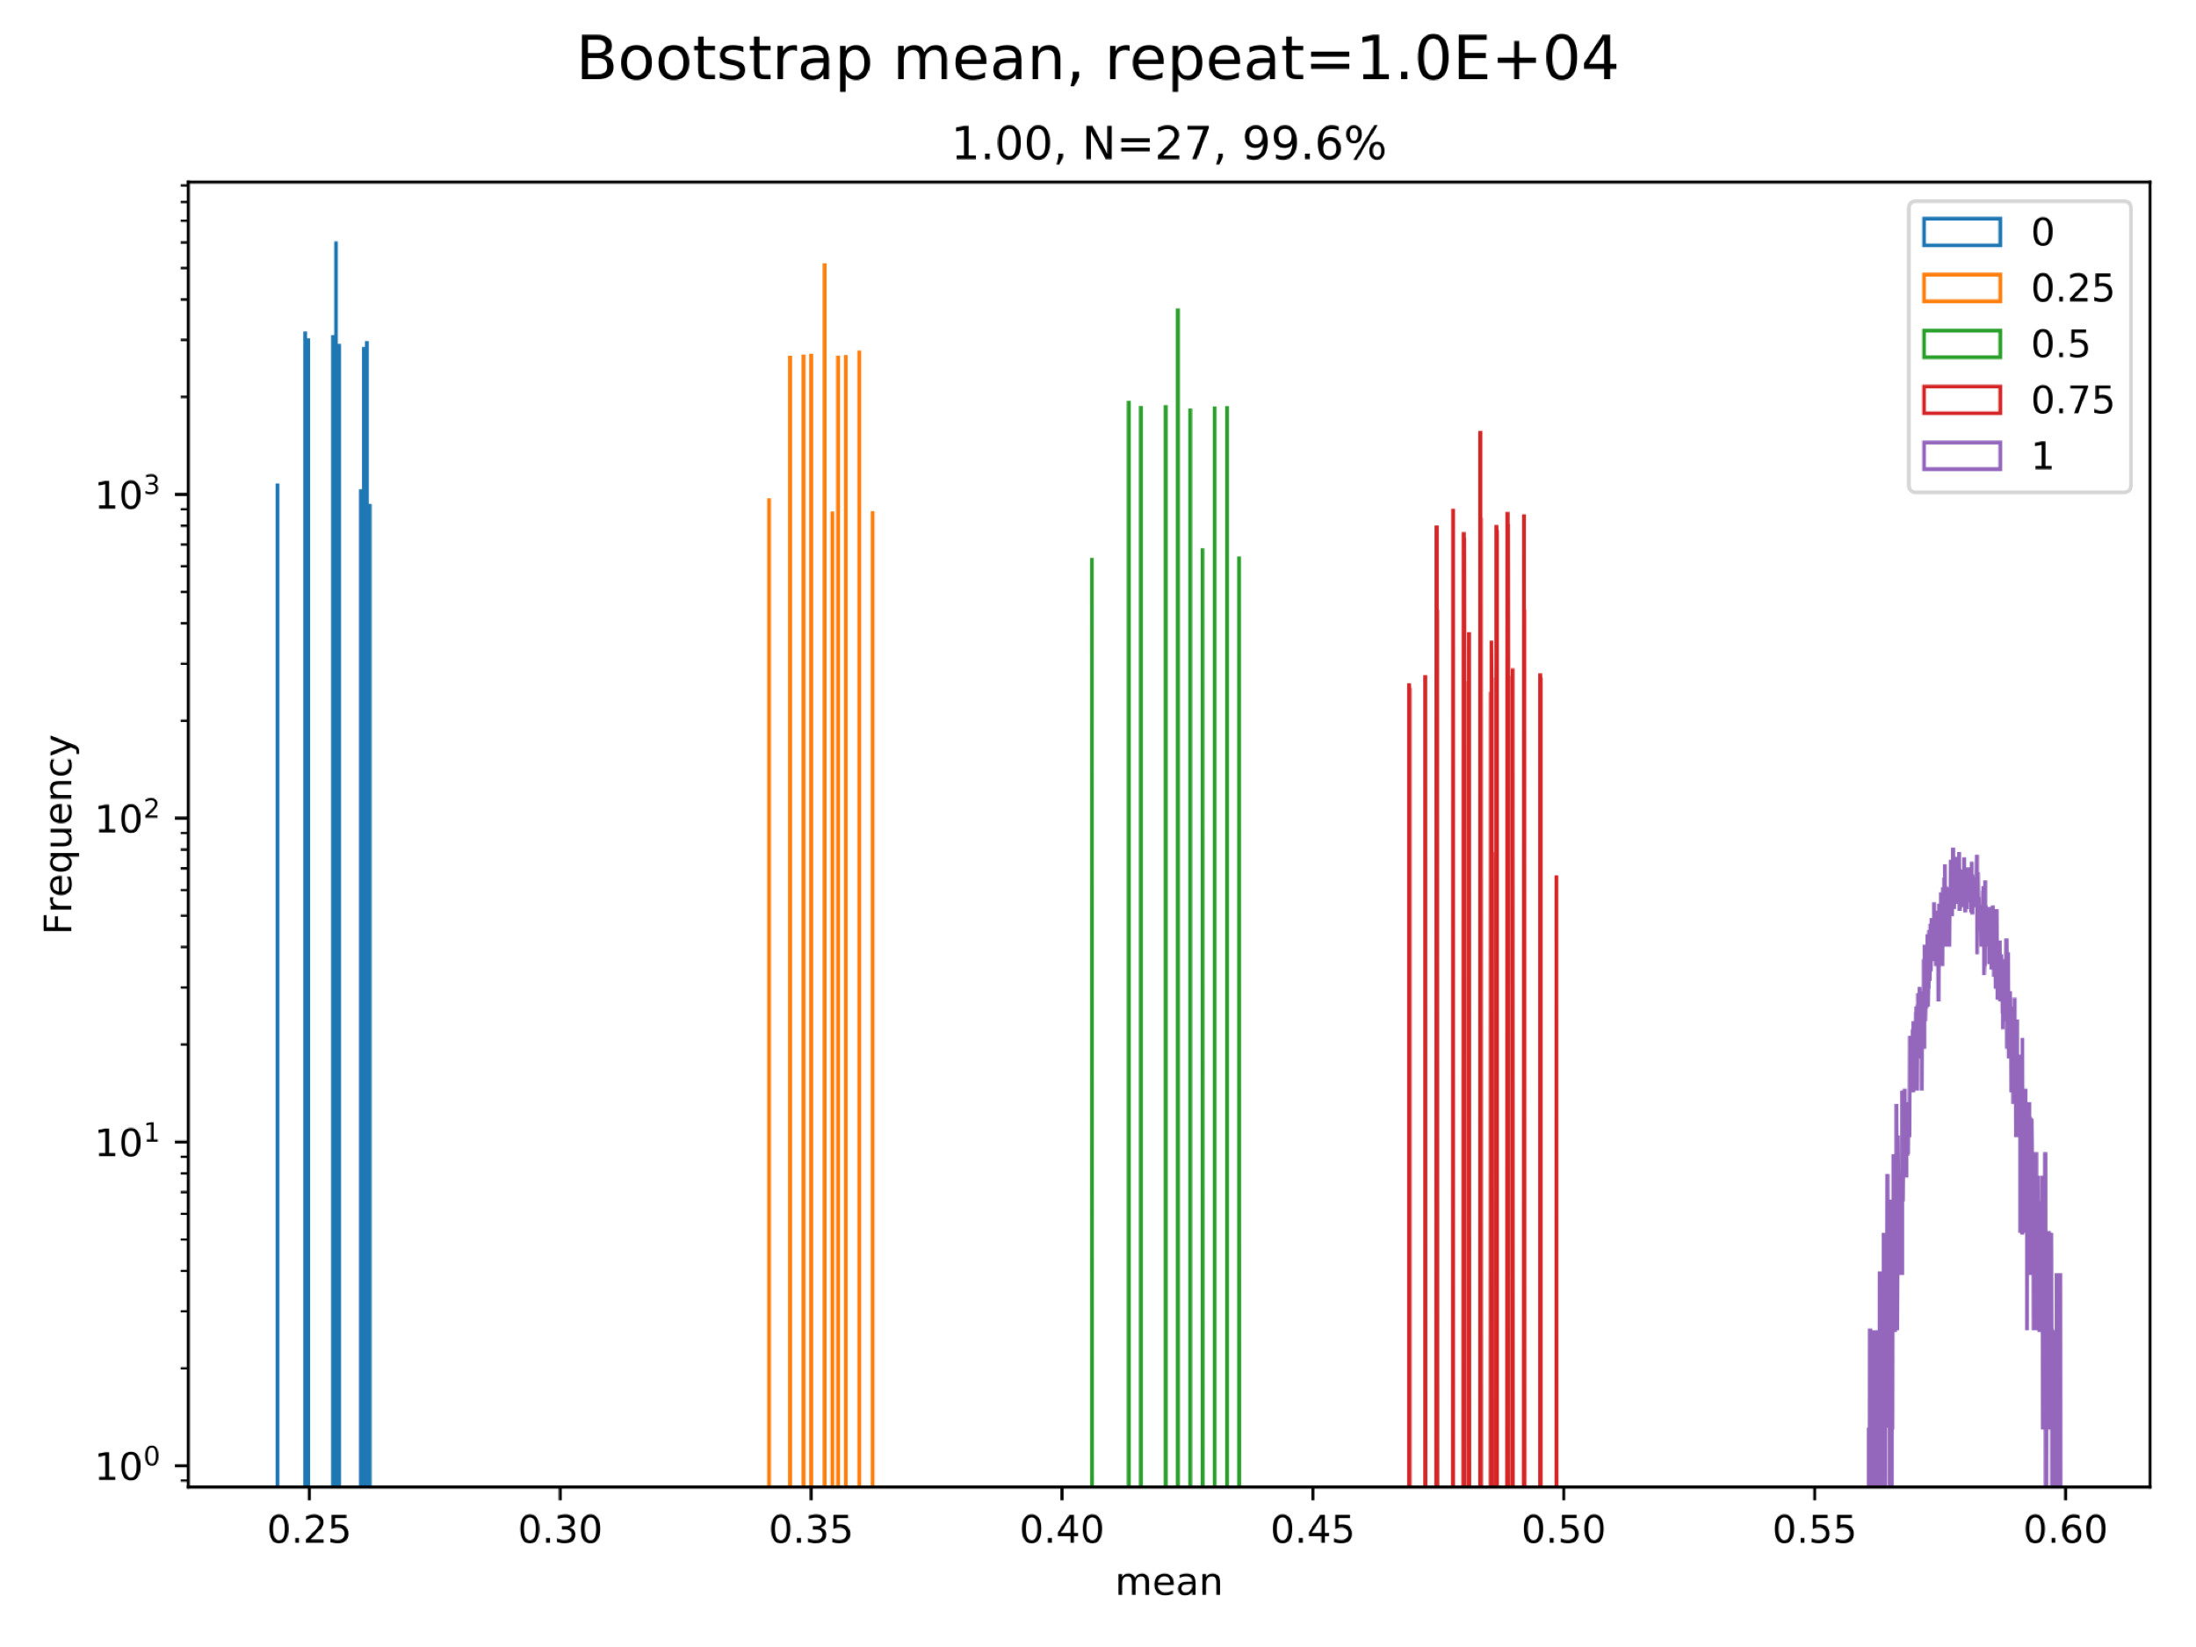
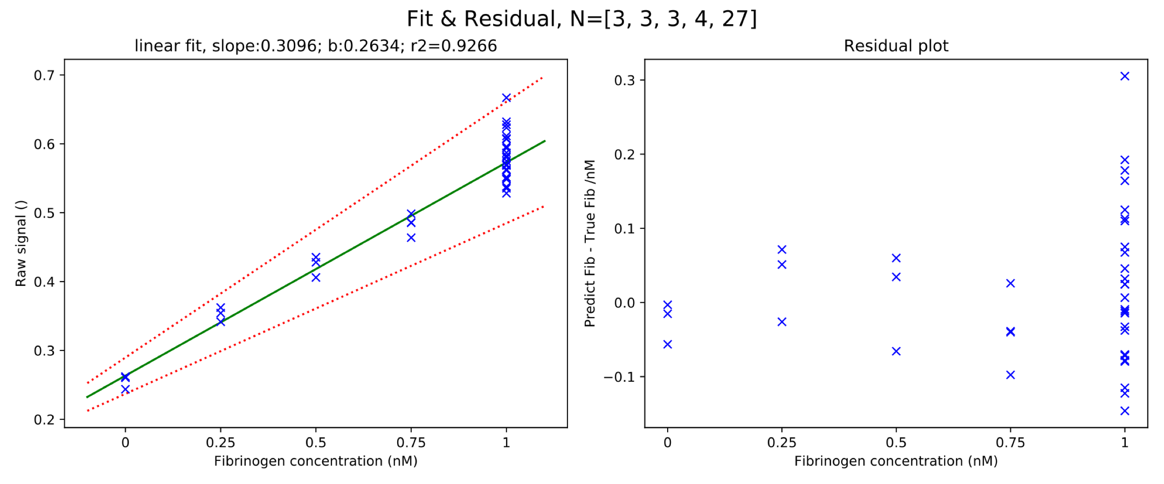
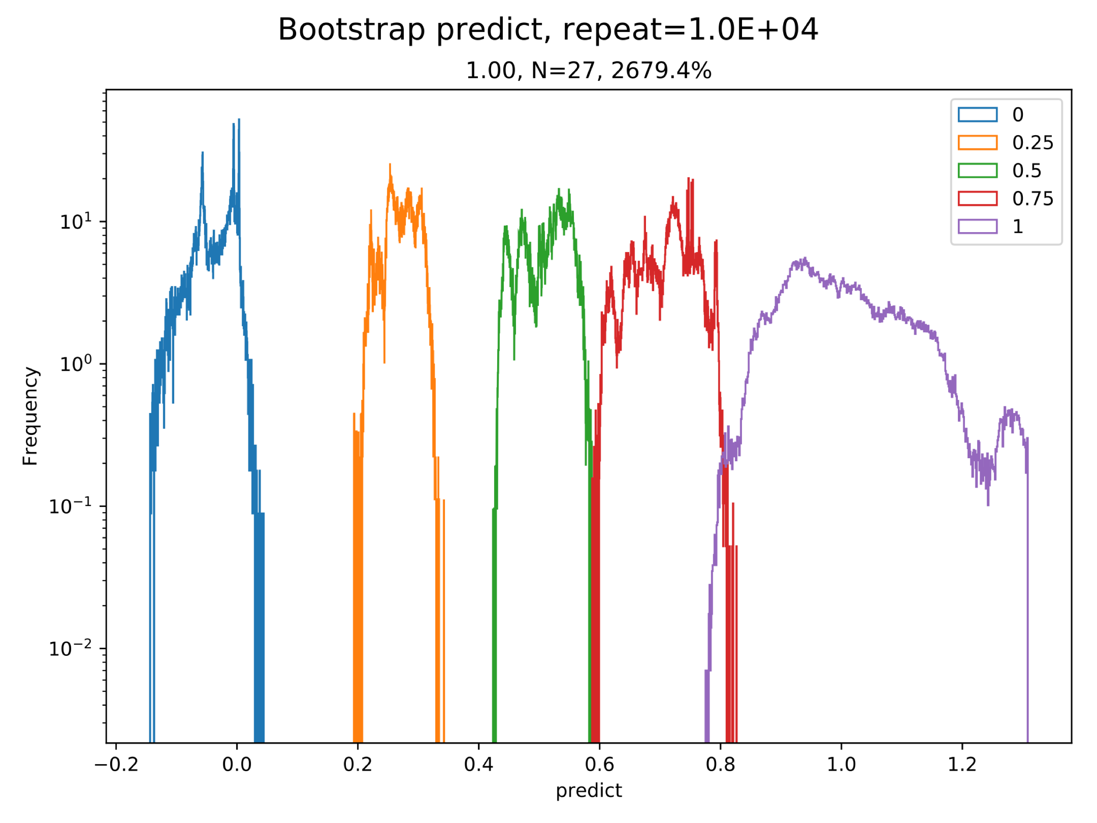
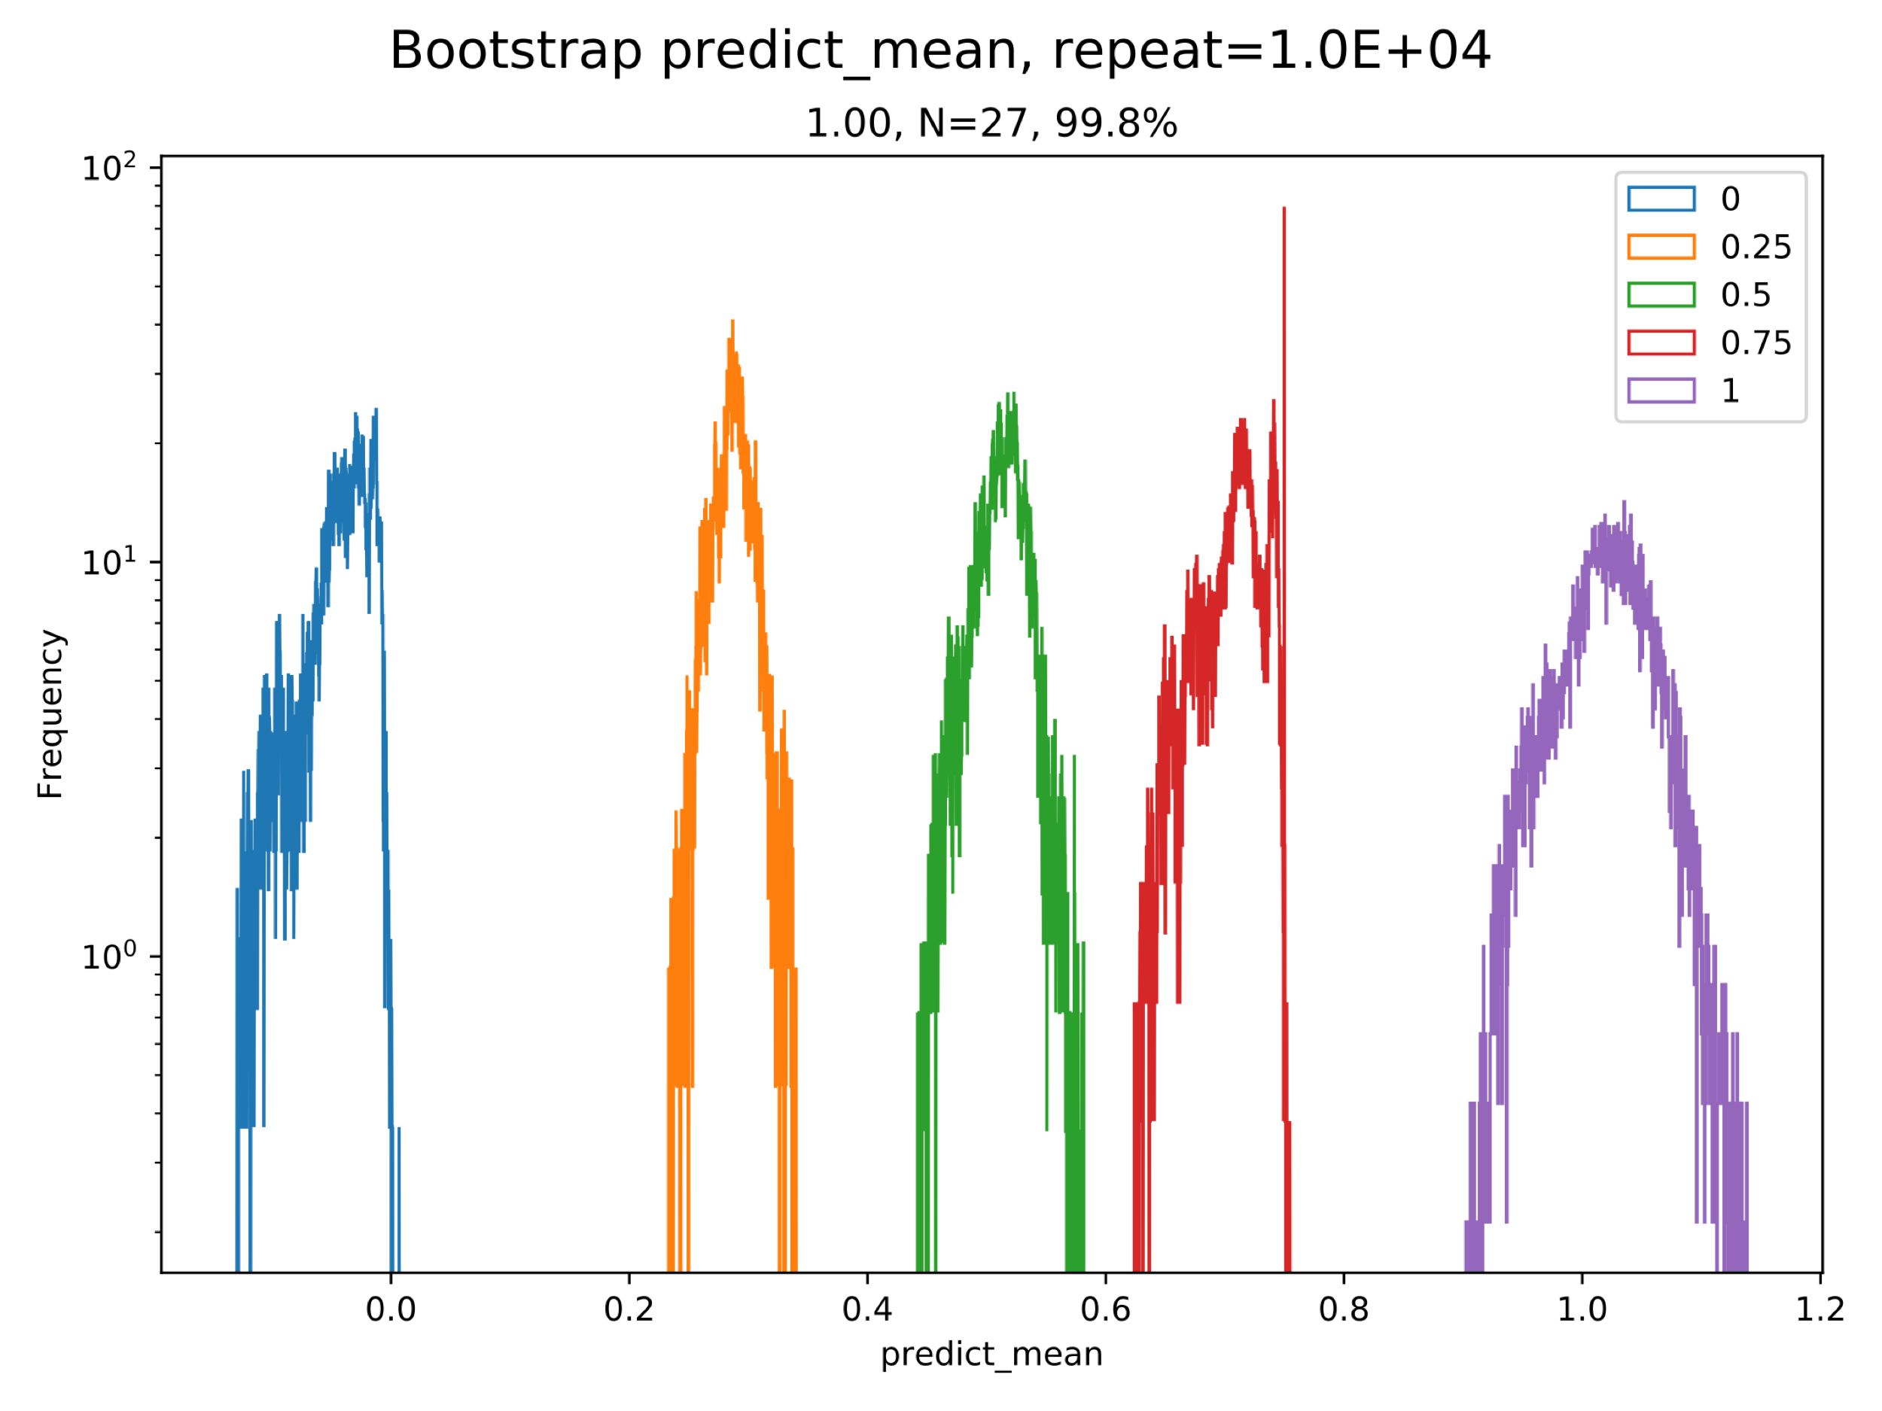
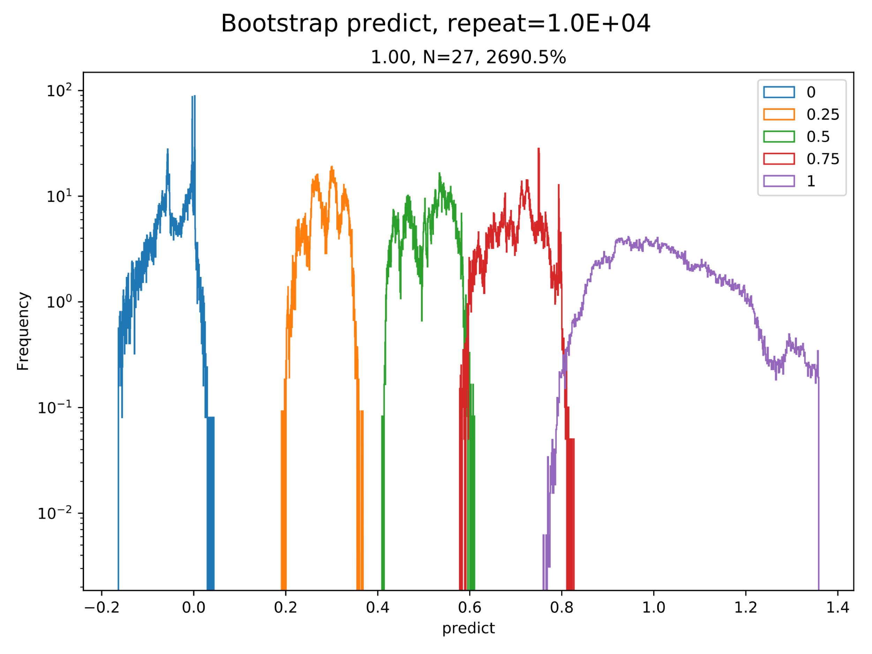
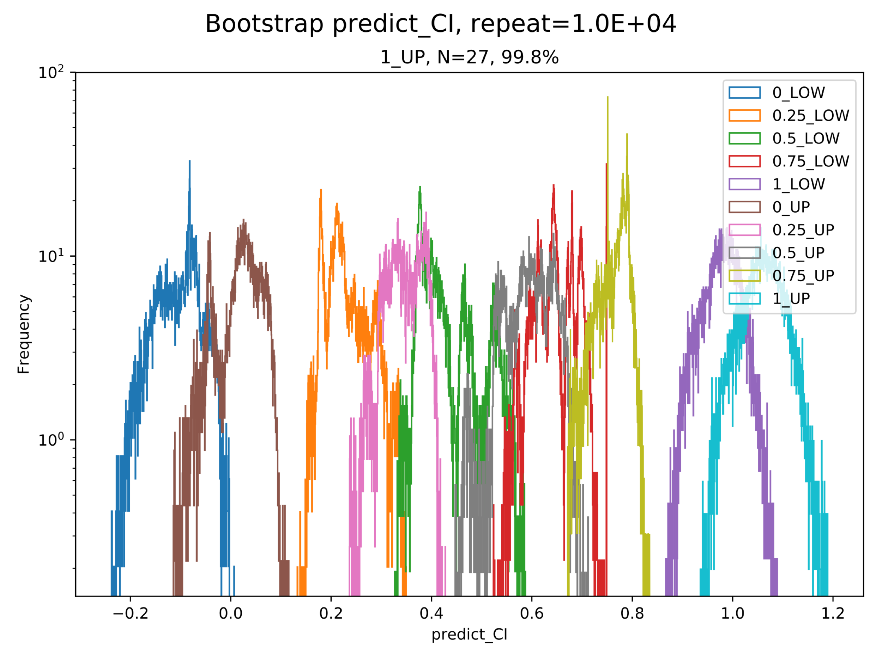
Bootstrapping from Slarkee
AQ NORMed

Slide 7
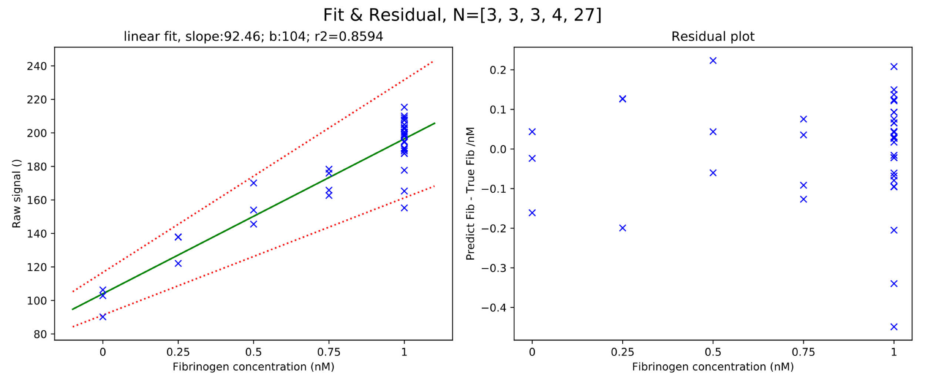
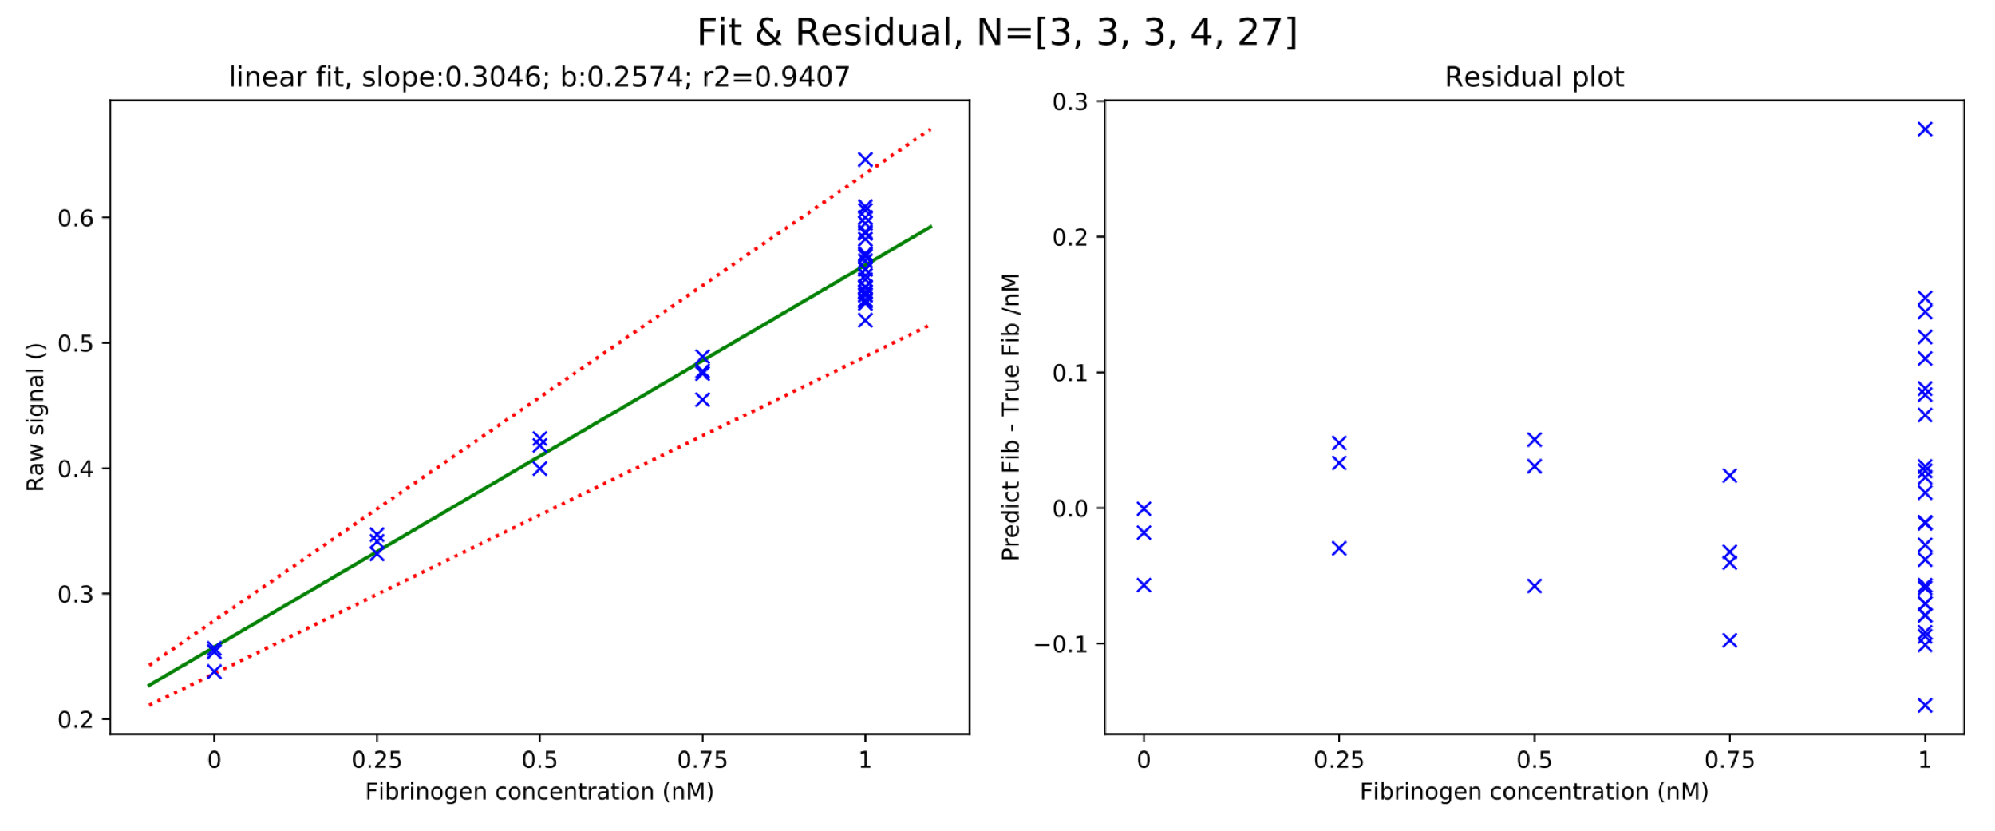
Bootstrapping from Slarkee
No AQ NORM vs AQ NORM-AVG

Slide 8
Bootstrapping from Slarkee
AQ norm _ AQ avg vs AQ-2

Slide 9
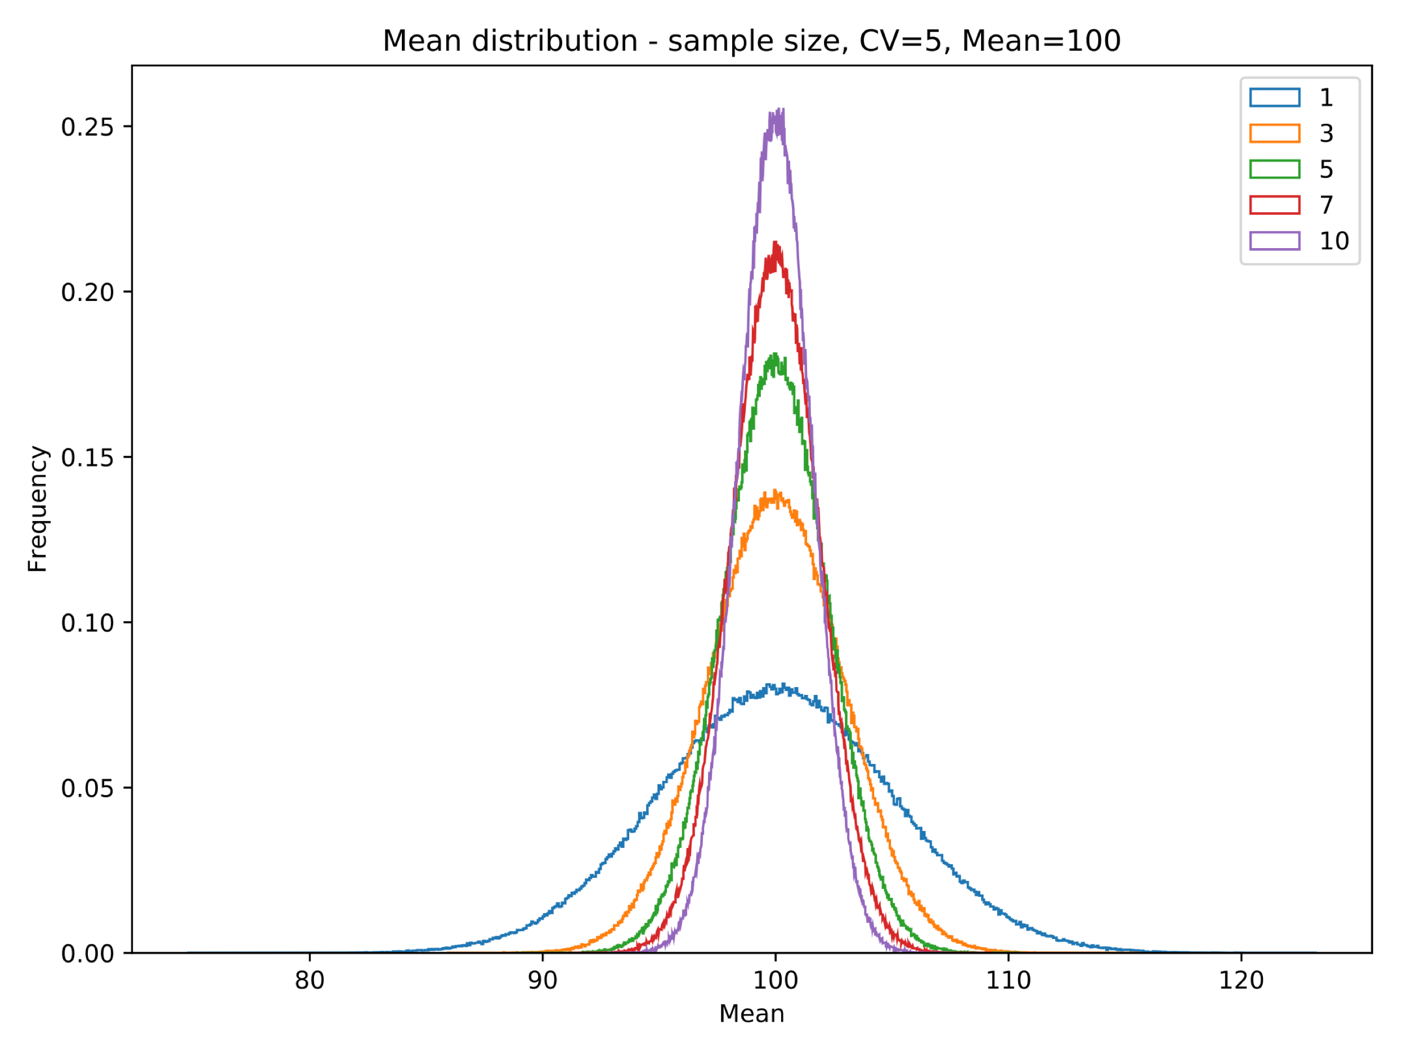
Sample size and Mean distribution
95% CI of Mean Mean=100 CV=5
Sample Size | Lower | Upper
1 | 90.23 | 109.79
3 | 94.33 | 105.66
5 | 95.61 | 104.38
7 | 96.29 | 103.71
10 | 96.90 | 103.09
Mean | Sample Size
No. | 1 | 3 | 5 | 7 | 10
1 | 96.06 | 104.44 | 105.54 | 98.19 | 100.90
2 | 98.89 | 101.61 | 98.67 | 100.59 | 99.09
3 | 108.67 | 98.93 | 98.05 | 96.32 | 99.73
4 | 95.91 | 99.10 | 97.36 | 100.12 | 104.23
5 | 110.79 | 97.27 | 99.17 | 98.97 | 102.26
6 | 104.90 | 103.65 | 97.82 | 103.64 | 100.18
7 | 100.97 | 100.01 | 106.06 | 100.58 | 99.27
8 | 99.25 | 95.38 | 100.93 | 100.34 | 99.91
9 | 104.53 | 104.40 | 102.49 | 98.82 | 102.01
10 | 89.56 | 101.46 | 101.30 | 97.25 | 99.18
11 | 94.67 | 102.96 | 103.48 | 101.50 | 100.40

Slide 10
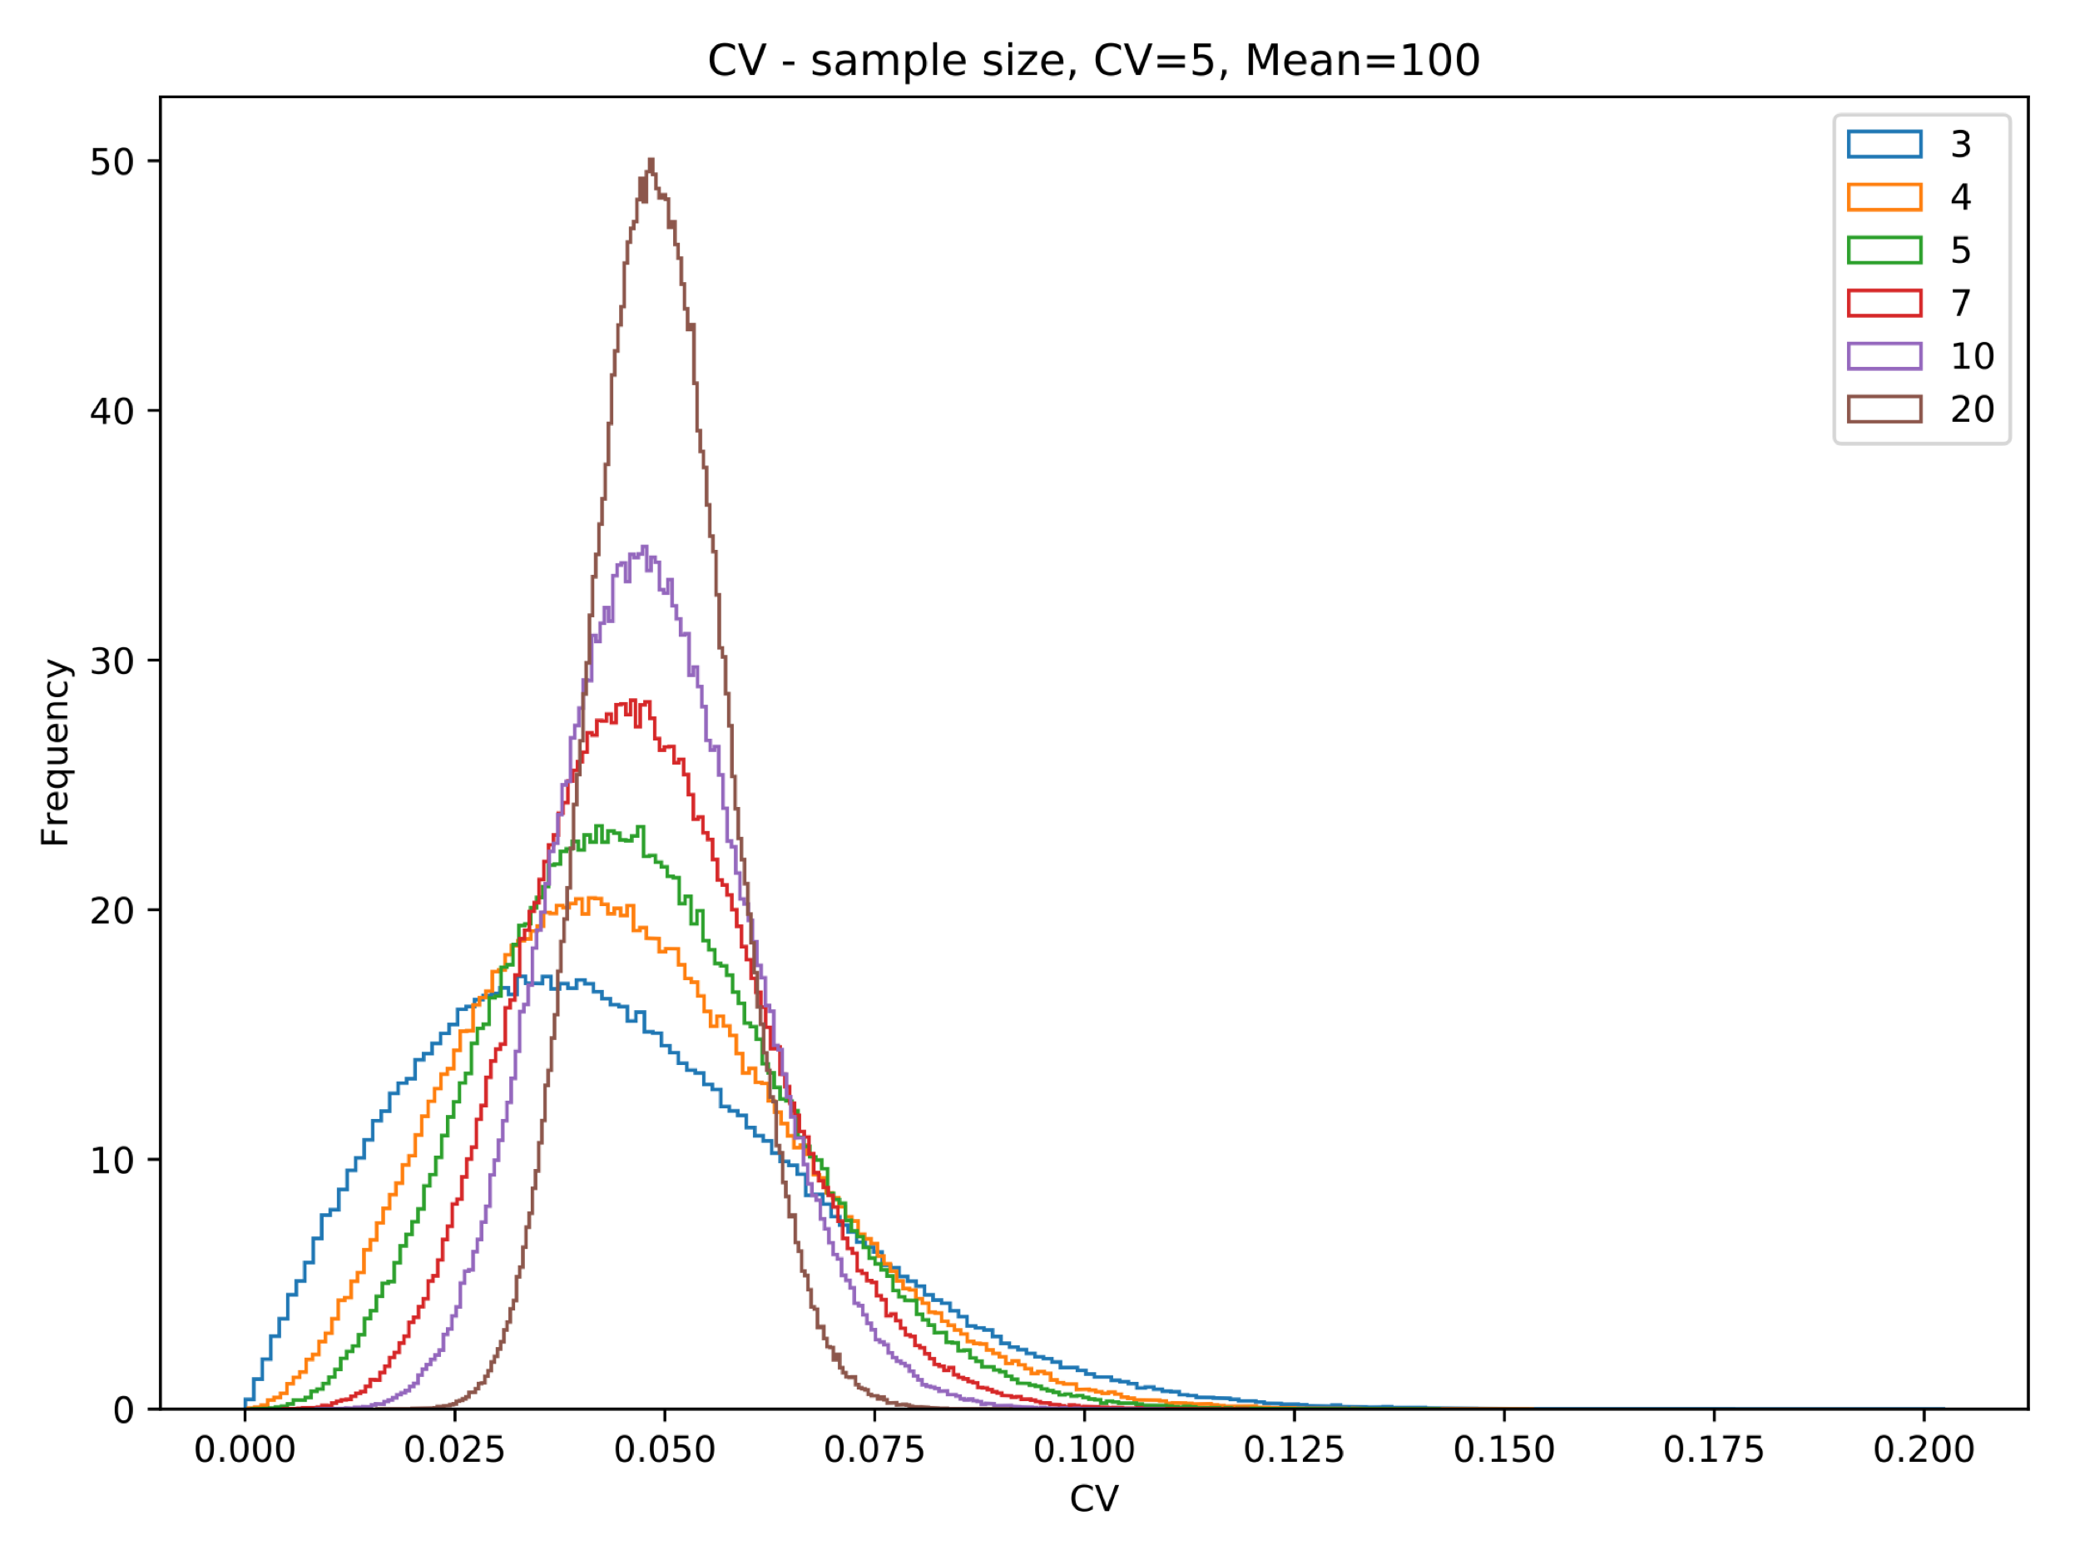
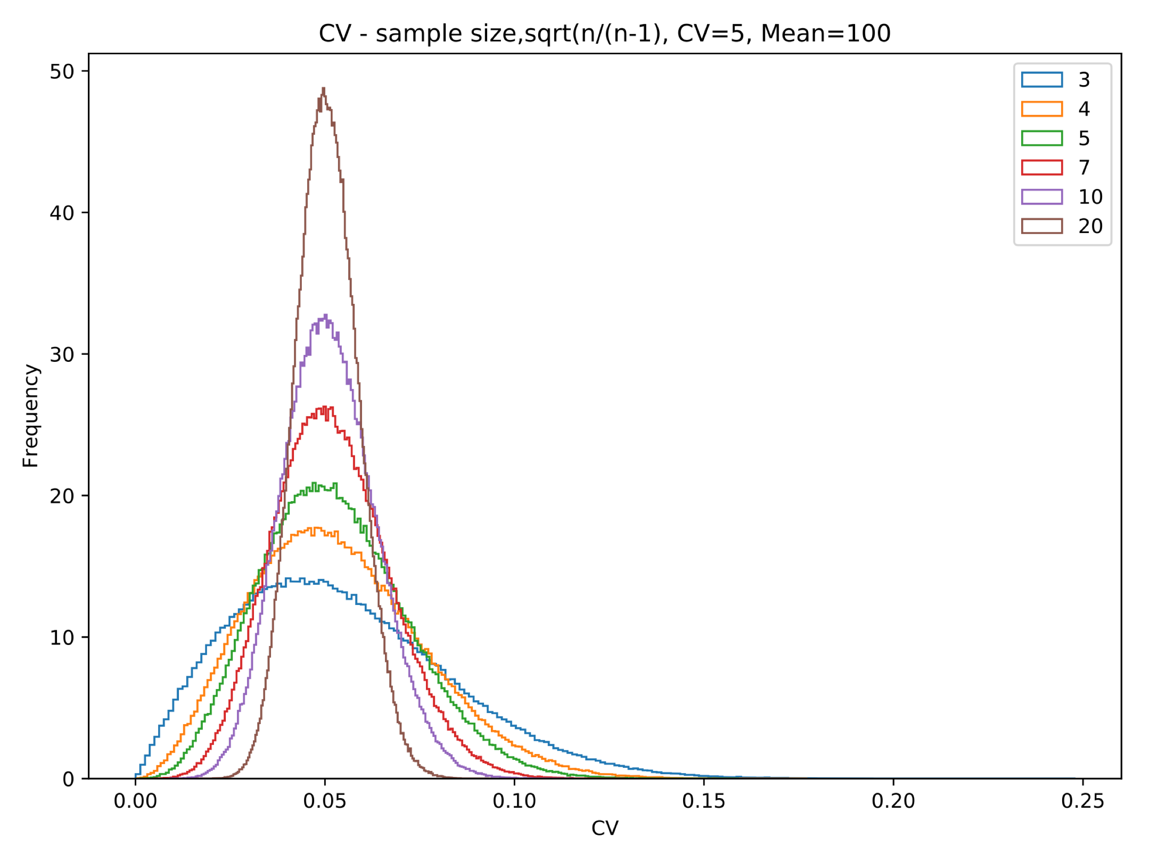
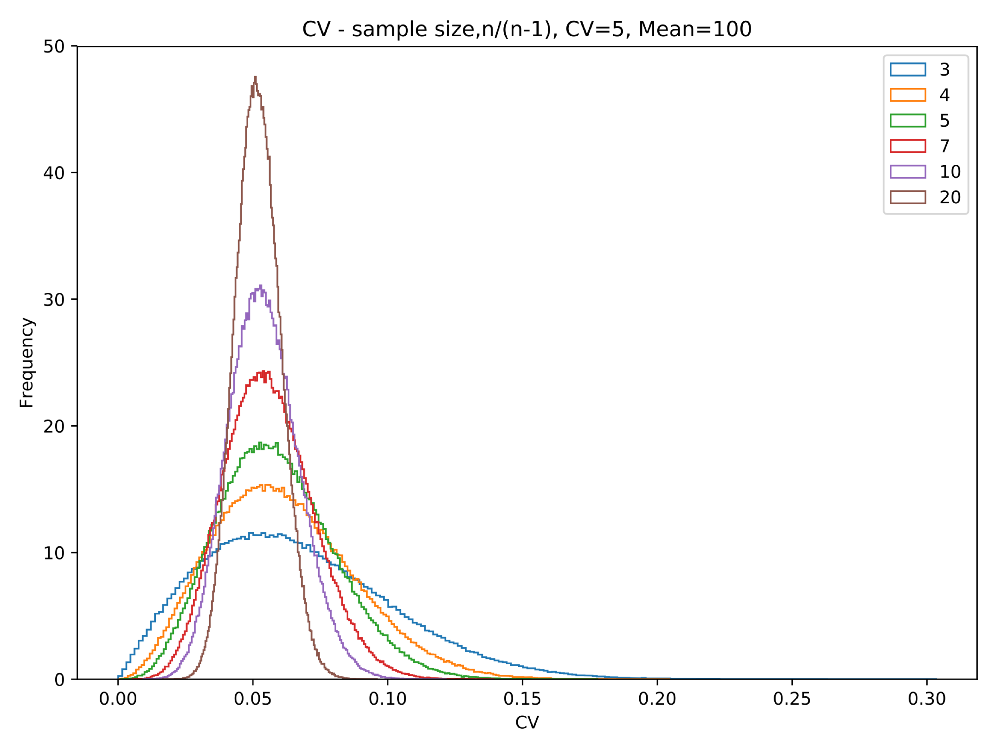
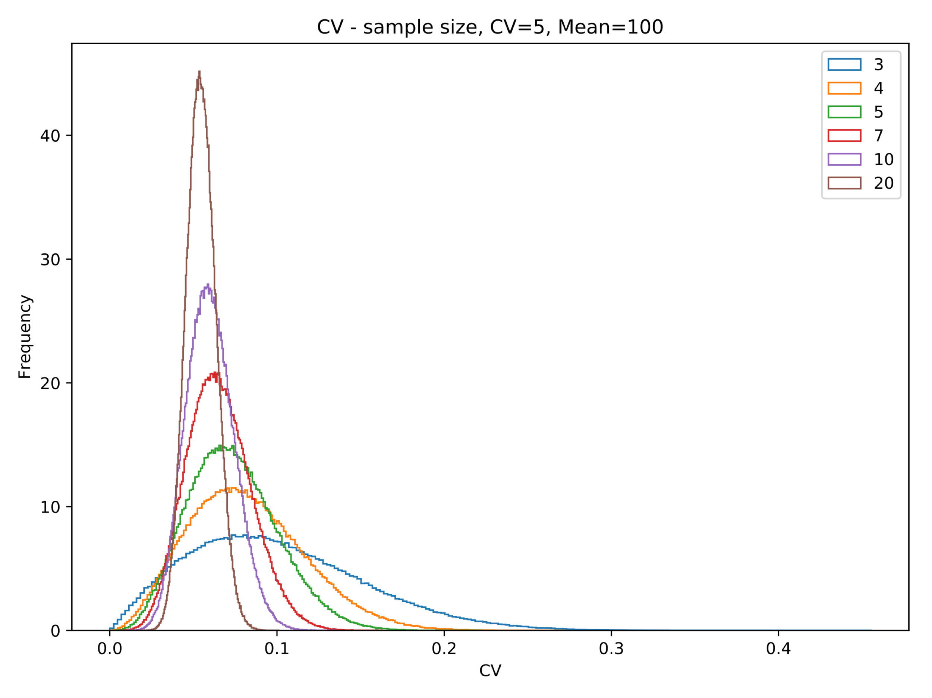
Correction for CV on small sample size.

Slide 11

Sample size and CV distribution
CV | Sample size
No. | 3 | 4 | 5 | 7 | 10 | 20
1 | 1.86 | 2.31 | 7.33 | 5.64 | 4.11 | 6.50
2 | 0.83 | 2.91 | 1.97 | 2.31 | 4.55 | 6.04
3 | 6.32 | 5.80 | 3.01 | 5.04 | 6.18 | 5.96
4 | 2.31 | 8.92 | 5.04 | 4.11 | 3.70 | 6.11
5 | 2.24 | 6.71 | 6.80 | 3.94 | 3.71 | 4.53
6 | 2.58 | 3.31 | 2.96 | 4.83 | 4.29 | 5.34
7 | 5.11 | 4.59 | 2.37 | 3.11 | 4.65 | 5.50
8 | 6.68 | 3.75 | 4.97 | 7.72 | 5.71 | 4.64
9 | 5.29 | 2.78 | 6.47 | 4.53 | 7.26 | 4.21
10 | 6.53 | 6.32 | 7.39 | 5.17 | 6.08 | 5.86
11 | 4.89 | 2.09 | 3.09 | 5.04 | 6.59 | 5.31
CV adjust comparison of different CV level

Slide 12
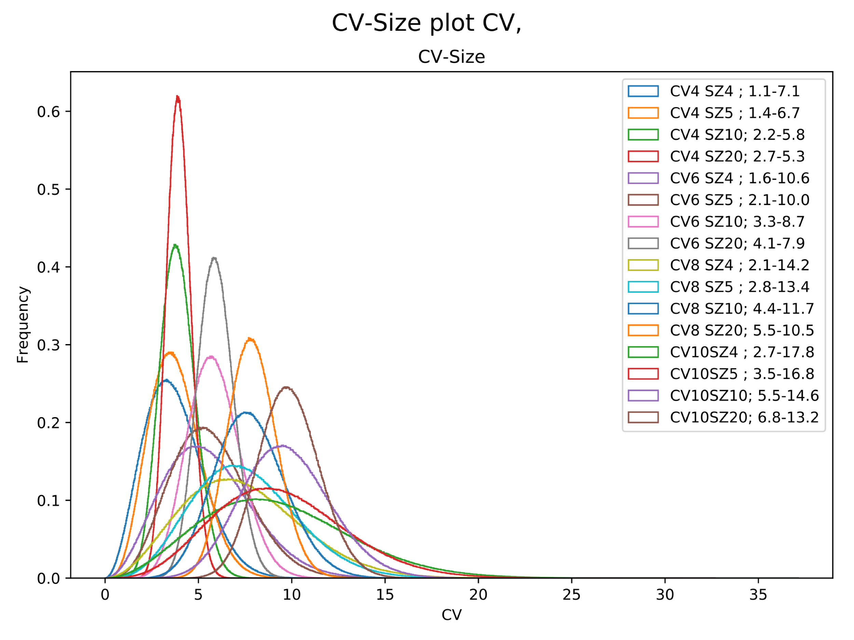
CV-Sample size relation

Slide 13
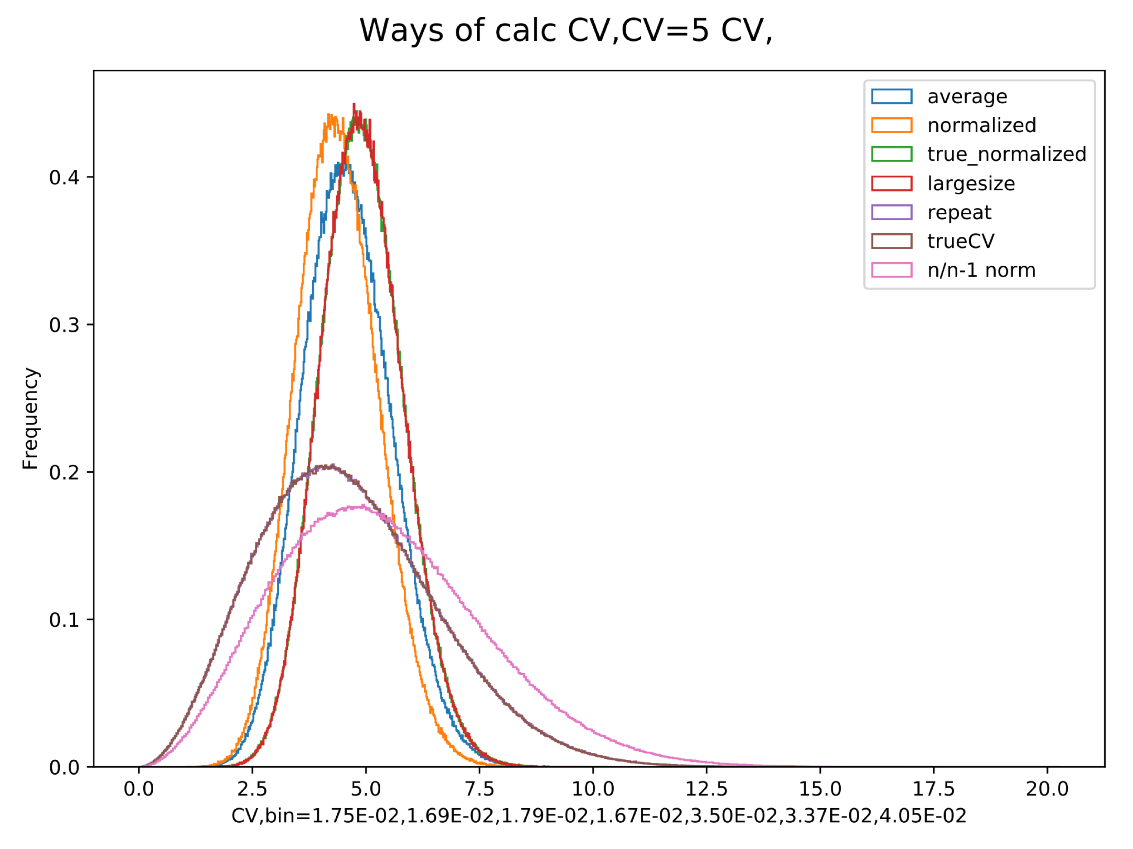
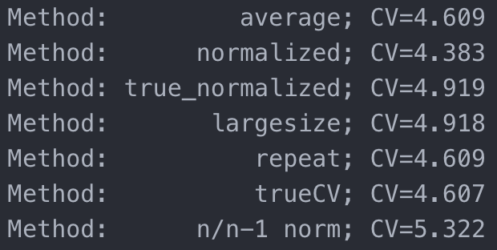
Different ways of aggregate CV from multiple measurements.
4 sample: mean = 50, 100, 150, 200,
each sample have fixed CV=5%;
In each repeat:
generate random measurement of each sample 4 times.
average: calculate CV for each sample, then average CV.
normalized: normalize each sample by the measurement mean, then pool all measurement (4X4 total measurement), calculate CV.
true_normalized: same as above, but use true mean for normalization.
largesize: measure the mean=100 sample 16 times each repeat.
repeat: calculate CV for 4 samples separately, and plot separately
trueCV: same as above, except when calculating CV, use true mean.
n/n-1 norm,: same as ”repeat” method, except multiply each CV by sqrt(n/n-1)
Repeat for 1e6 times;
plot the histogram of CVs calculated form above methods;
and their mean value:
Conclusion:
taking average of multiple small size measurement is OK method for getting more consistent CV measurement.
however, it’s not as good as pooling all measurement of the samples with same mean then calculate CV: this is similar to increase sample size.
Then we can compare CV among different samples and decide if they are similar.

Slide 14
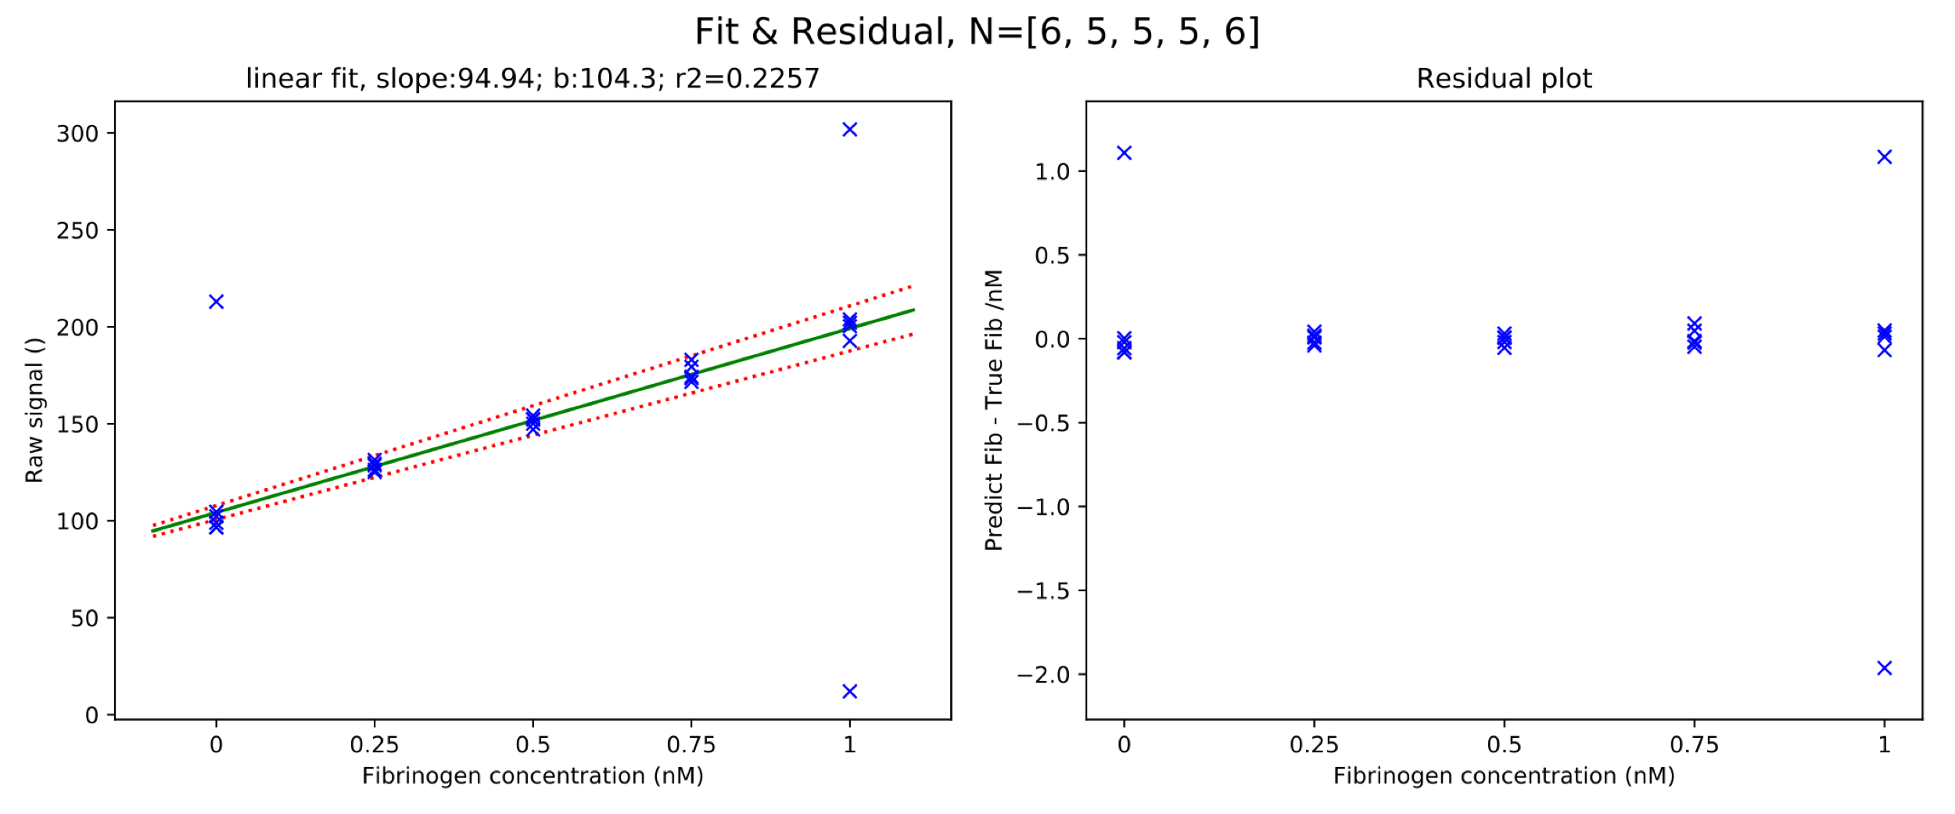
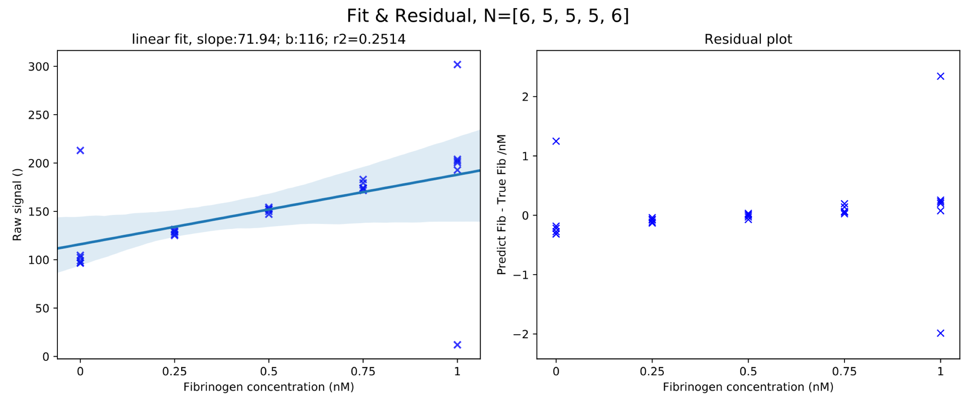
Curve fitting with multiple repeated measurement of the same X
if don’t use multi X group together and use mean value to fit, fitting is not good. will be easily screw up by outliers. (because fitting is done with least square fit, and it’s prone to be affected by outliers.
y=100x +10 0
CV=2% for first 3 points
15% for 1X point.
Fit method 1:
use mean to fit
In Prism, this function is provided by using “mean” to fit.
Fit method 2:
use all points to fit
CI is generated by bootstrap
<seaborn package>
Raw data | 0 | 0.25 | 0.5 | 0.75 | 1
0 | 96.65333278 | 125.0823684 | 147.0574361 | 183.023151 | 301.8401
1 | 104.569856 | 129.4225107 | 152.1818112 | 179.3996458 | 200.3341
2 | 98.92107413 | 128.576369 | 152.4227391 | 173.5436862 | 202.1593
3 | 96.55352355 | 126.2862311 | 150.0696645 | 171.6607328 | 203.8554
4 | 102.3239728 | 131.3785907 | 154.1931861 | 174.2840931 | 192.7843
5 | 213 |  |  |  | 12

Slide 15
To test:
Divide two random number for CV.
use different mean value to predict CV.
what CV will be good for distinction between conc.
robustness of bootstrap analysis.
generate reports
prediction interval vs confidence intervals
CV of simulated data.
p value of two cv measurements.

Slide 16
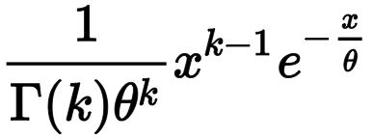
Gamma distribution Probability density function
PDF of CV measured from size N sample is gamma distribution:
sample size N = k, CV/N = θ

Slide 17
The Confidence interval generated in Prism is not meant for our application

Slide 18
robustness of bootstrap analysis. CV=5, signal from ~ 59 to
seed for bootstraping
Conc. | Raw_Mean | Raw_CV
0 | 54.39 | 5
5 | 63.25 | 5
7.5 | 70.51 | 5
12.5 | 80.48 | 5
25 | 102.49 | 5

Slide 19
Robustness of bootstrap from different sample size
use 5 samples generated from a data of

Slide 20
Bootstrap from different slopes of the curve

Slide 21
bootstrap from different background of curve

